Slide 1
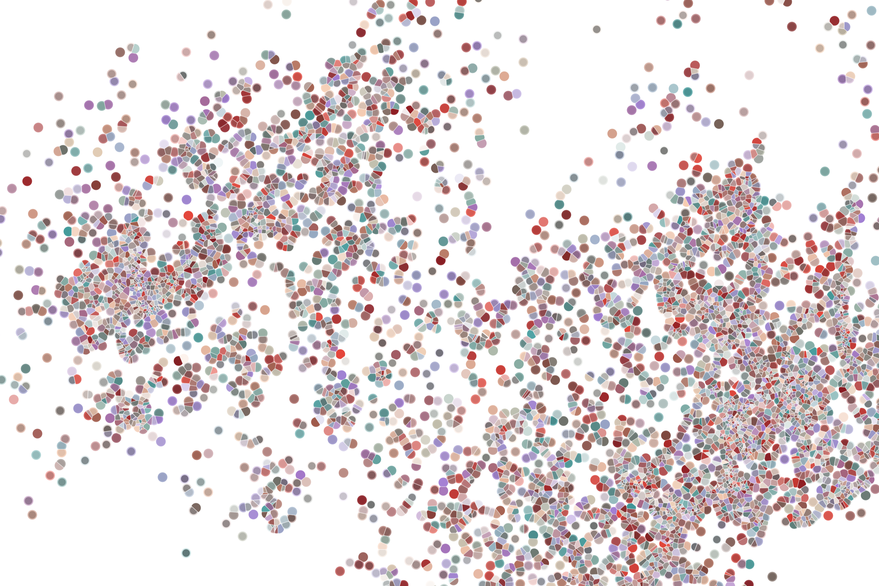
Package dissemination
Physalia course 2022
Instructor: Jacques Serizay
Notes:
Hello everybody and thank you for attending my presentation. I am going to talk about the project I recently started working on in the Spassky and Koszul labs, both located in Paris. This project focuses on the unusual cooption of the mitotic machinery to drive, not cell division but cell differentiation.

Slide 2
Incentivize other people to use your package
Your computer:
Many computers:
myPackage/
R/
functions.R
utils.R
man/
myfunction.Rd tests/
testthat.R
testthat/
test-myfun.R
inst/
extdata/
<raw-data-file>
data/
<data>.Rda
vignettes/
myPackage.Rmd
DESCRIPTION
NAMESPACE
README.md
NEWS
LICENSE
myPackage/
R/
functions.R
utils.R
man/
myfunction.Rd tests/
testthat.R
testthat/
test-myfun.R
inst/
extdata/
<raw-data-file>
data/
<data>.Rda
vignettes/
myPackage.Rmd
DESCRIPTION
NAMESPACE
README.md
NEWS
LICENSE

Slide 3
Incentivize other people to use your package
Well-made documentation package
or/and:
Package “advertisement”, a.k.a publishing…

Slide 4
Implement documentation website for your package
Once again, a package is available in R to help you!
pkgdown let’s you easily create a documentation website.

Slide 5
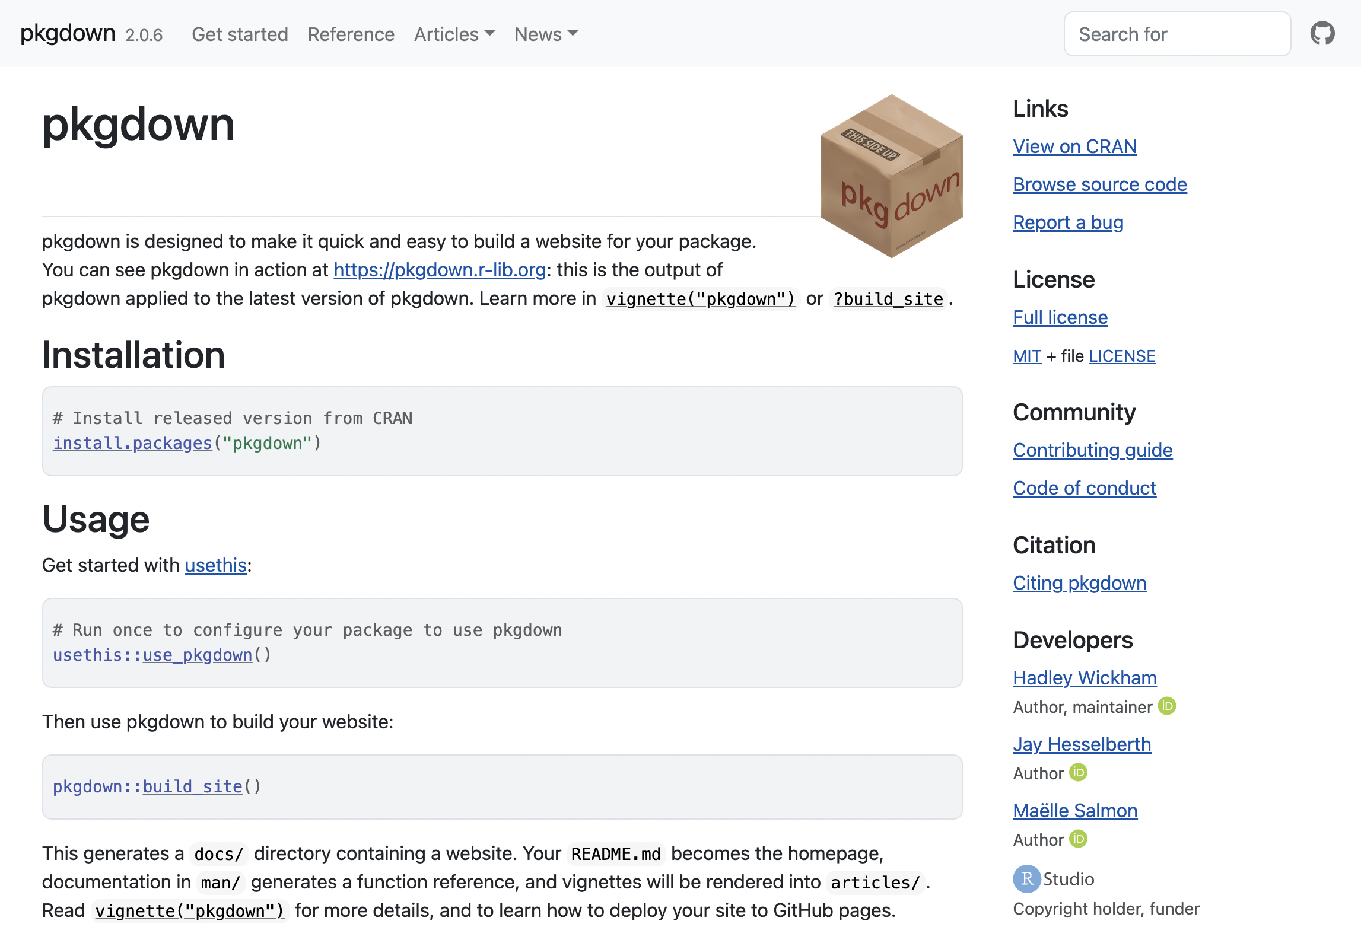
Implement documentation website for your package
Once again, a package is available in R to help you!
pkgdown let’s you easily create a documentation website.

Slide 6
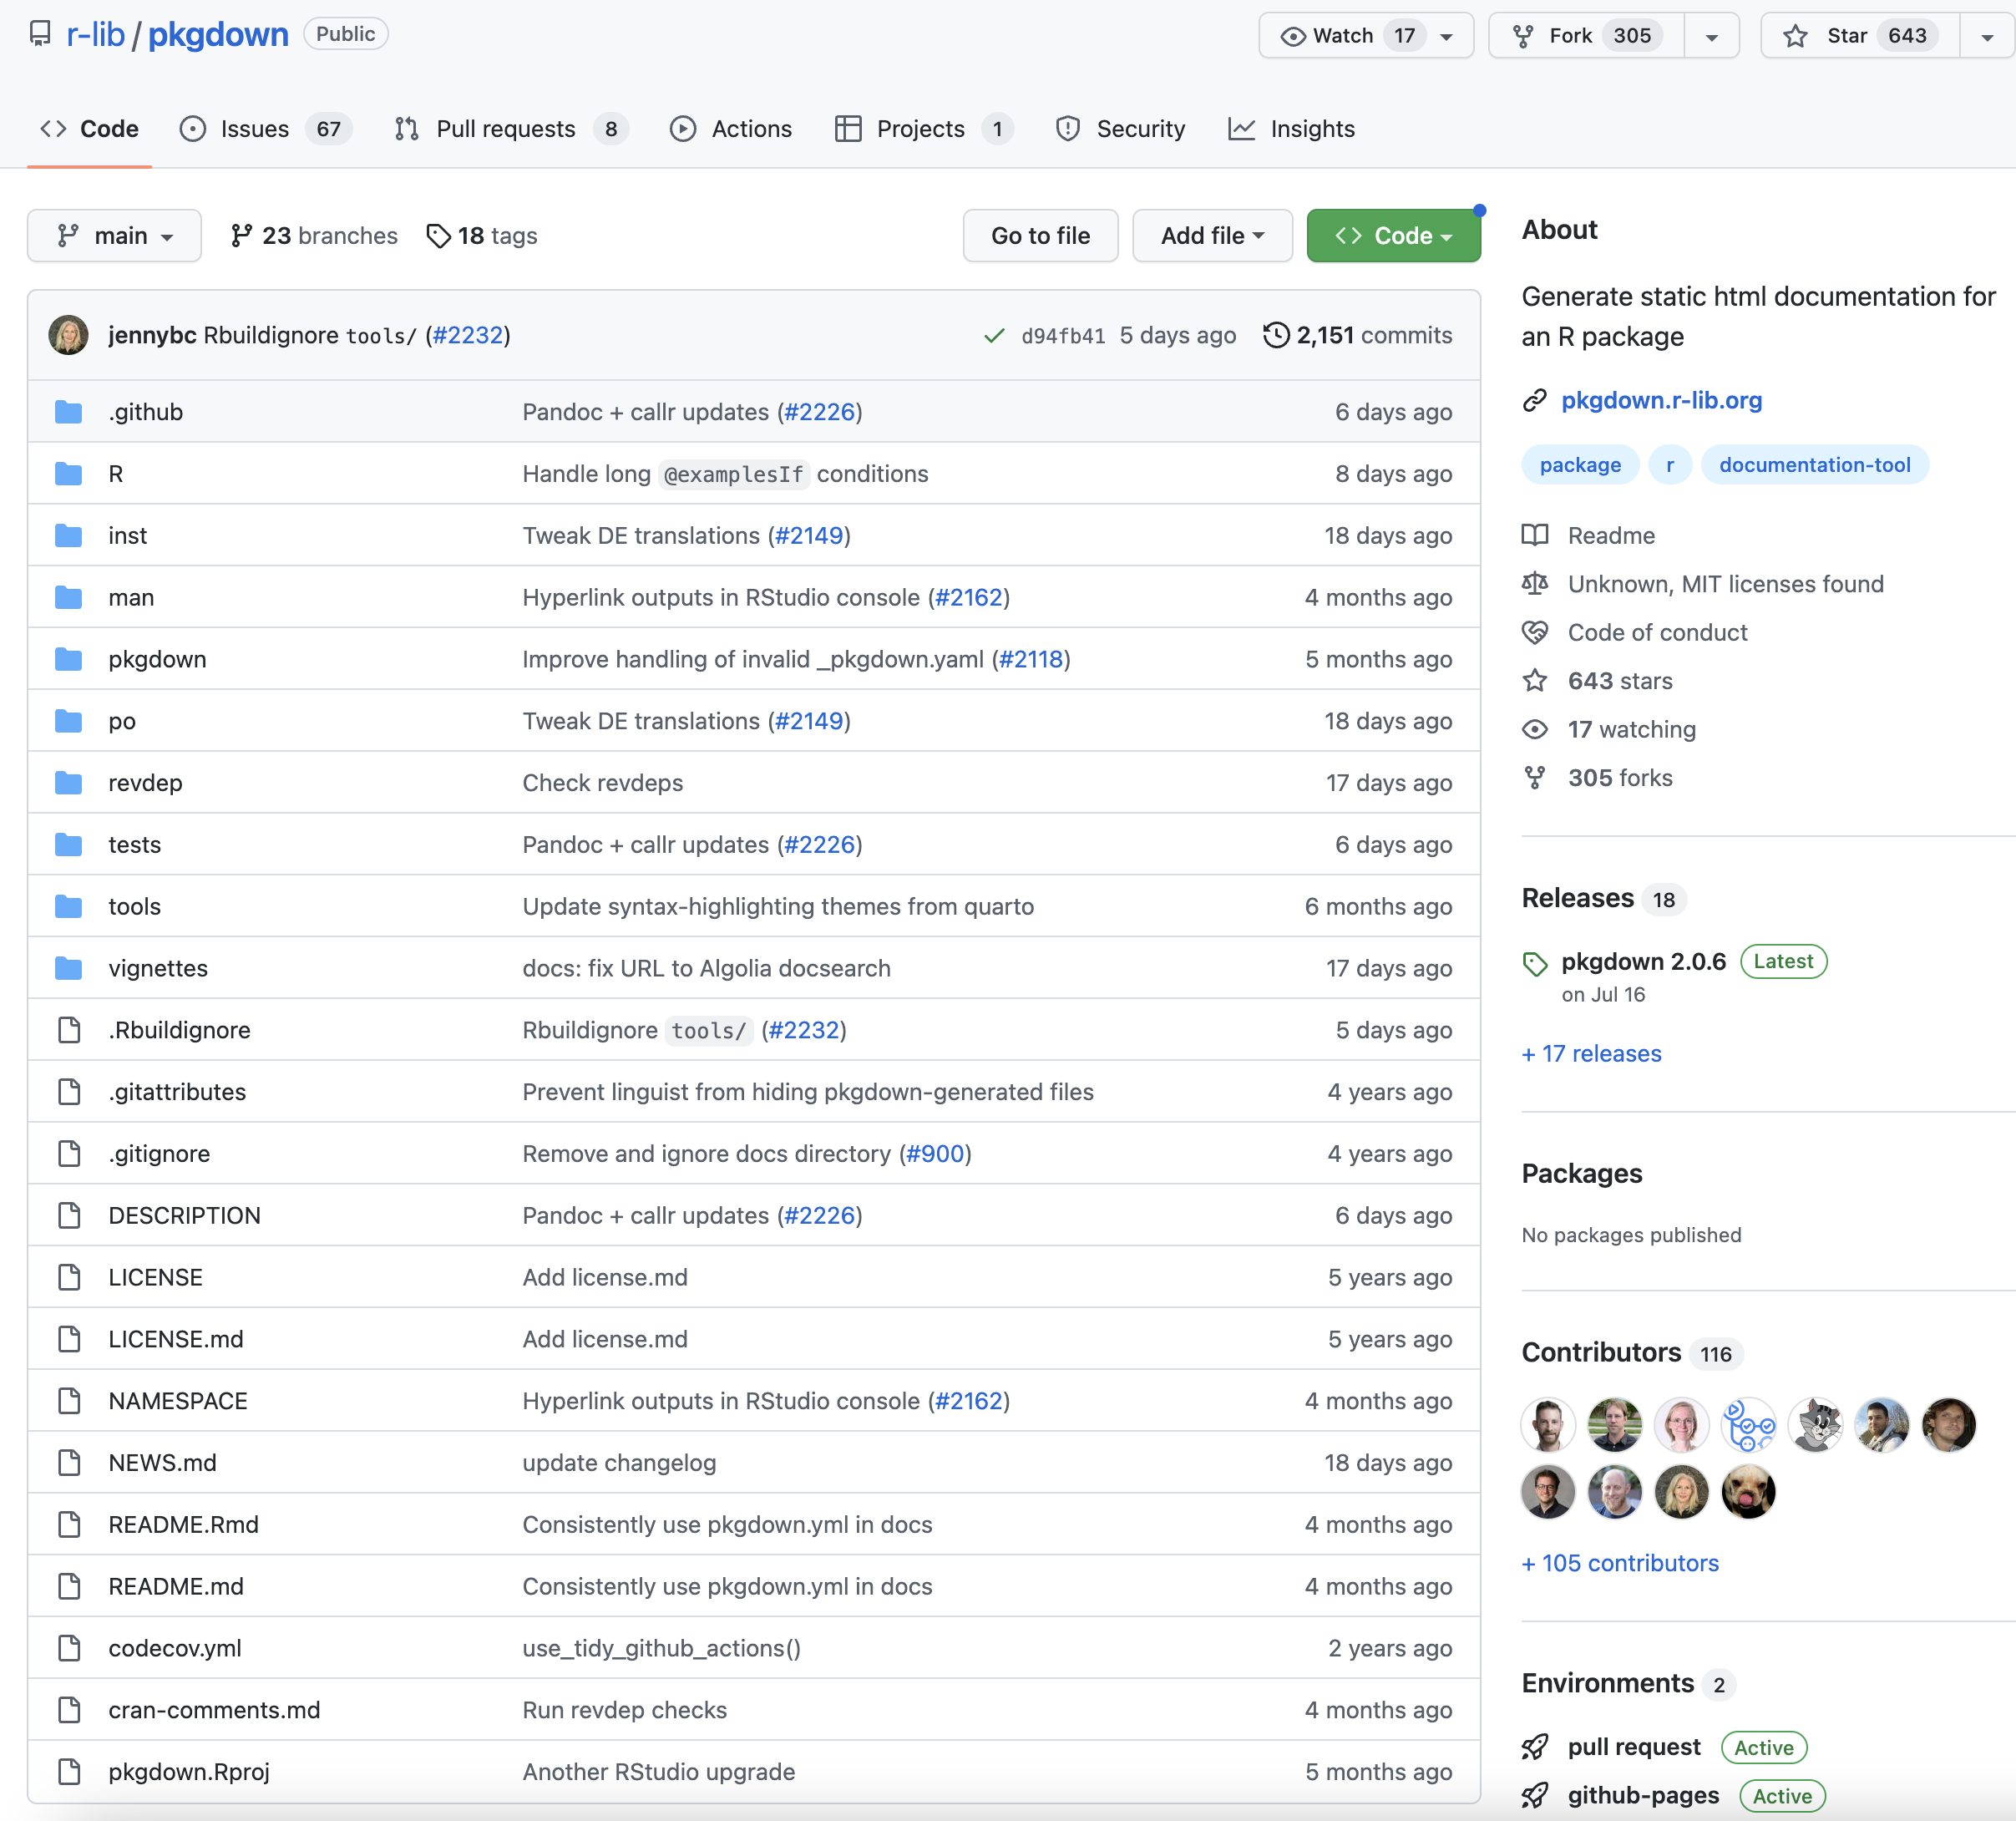
Implement documentation website for your package

Slide 7
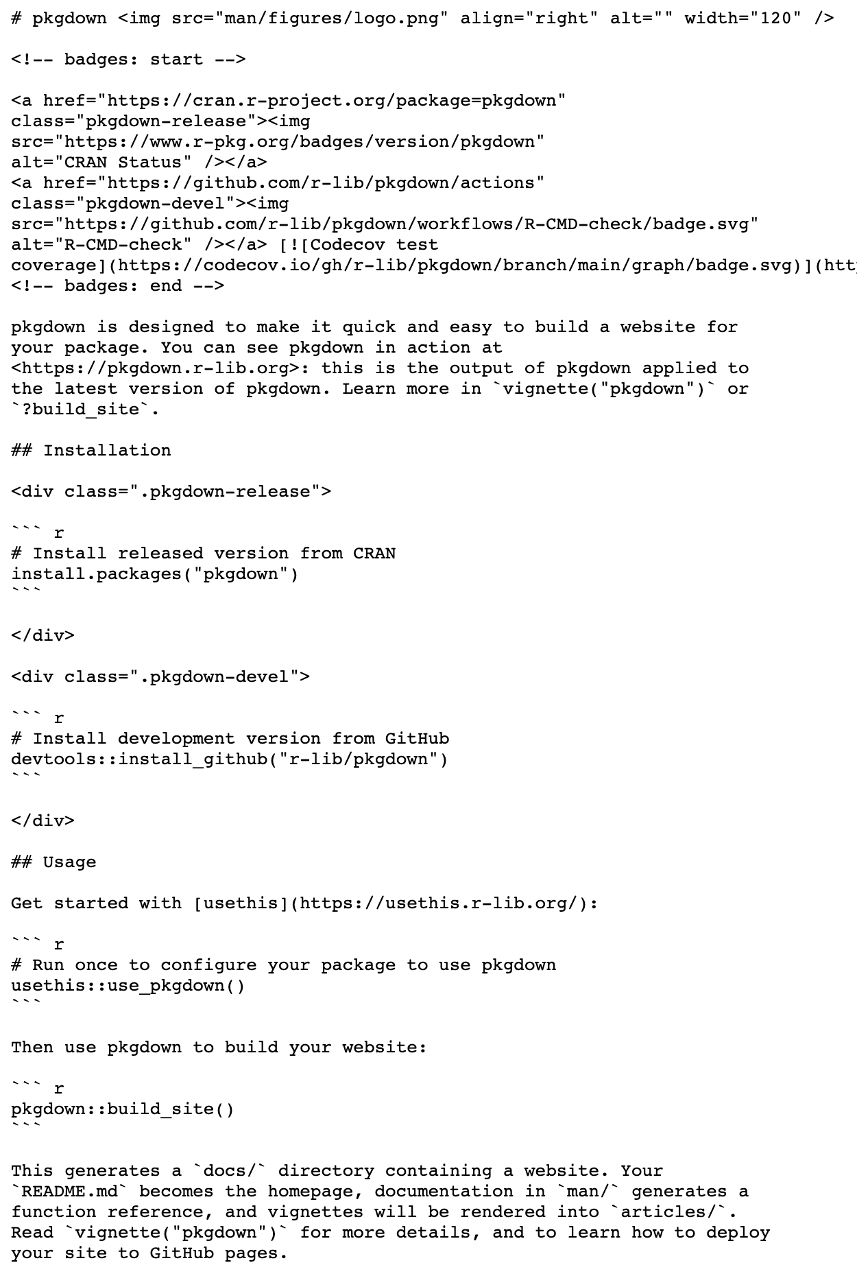
Pkgdown functionalities
Parsing of R package files in html code
README.md
pkgdown.r-lib.org/

Slide 8
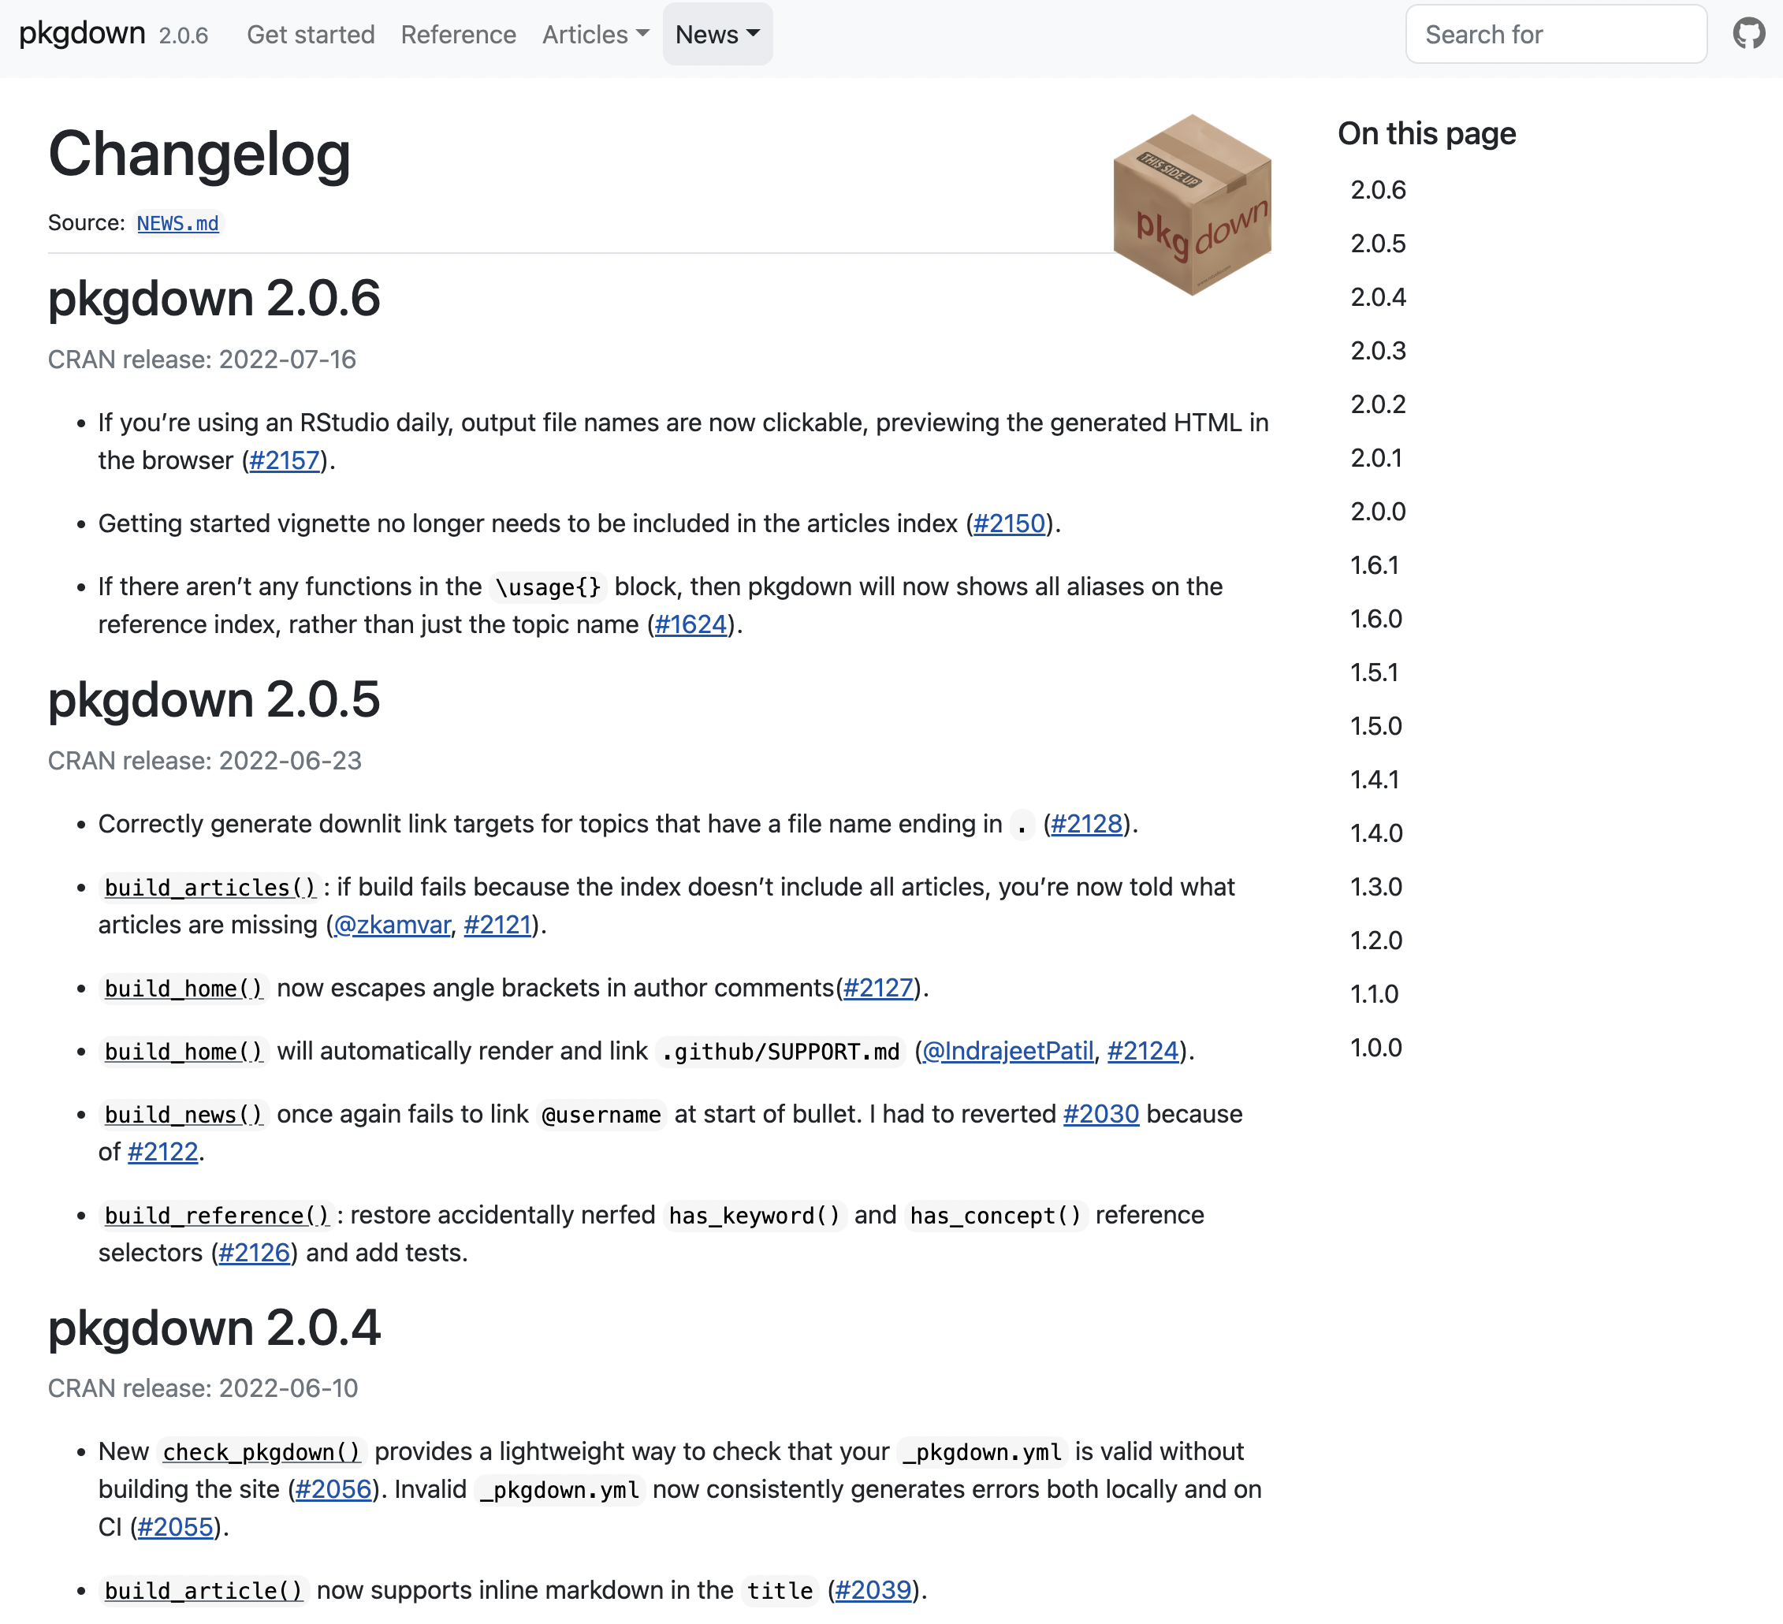
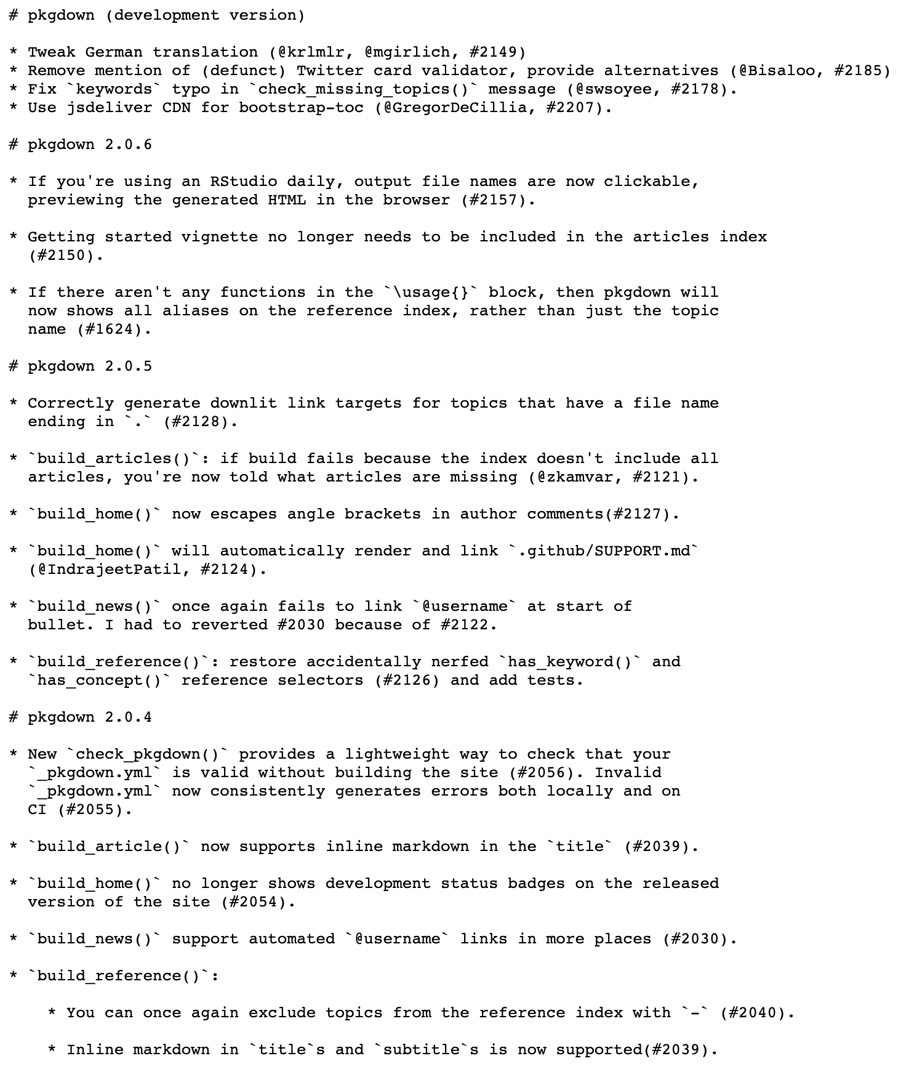
Pkgdown functionalities
Parsing of R package files in html code
pkgdown.r-lib.org/news
NEWS.md

Slide 9
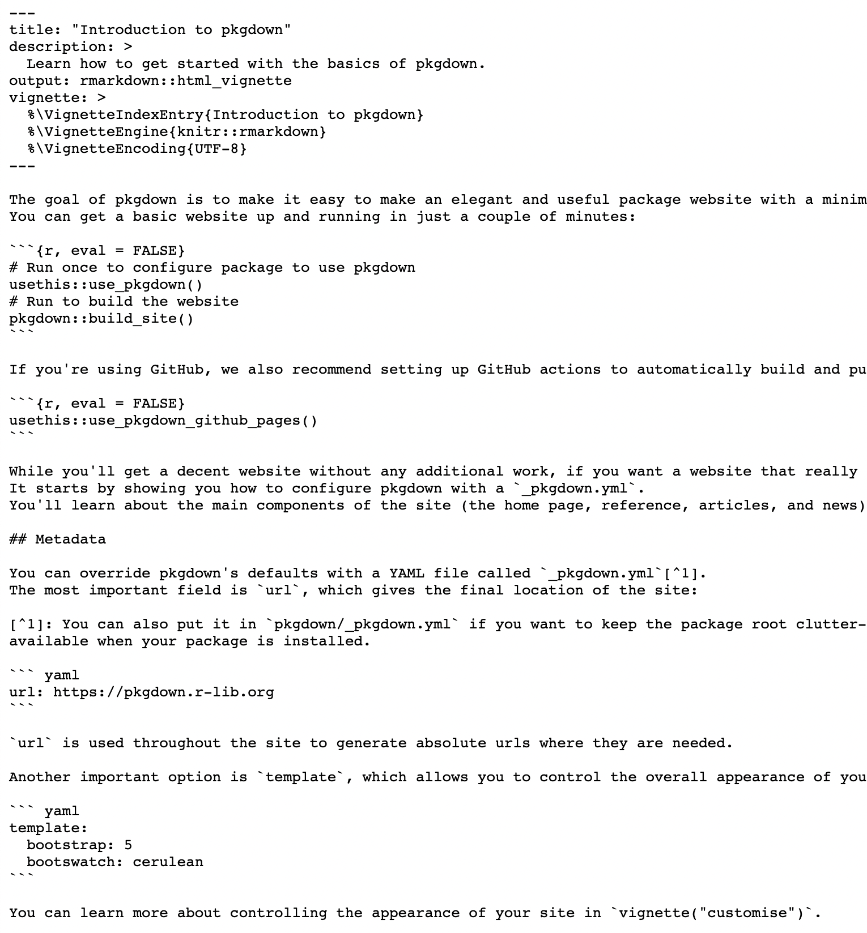
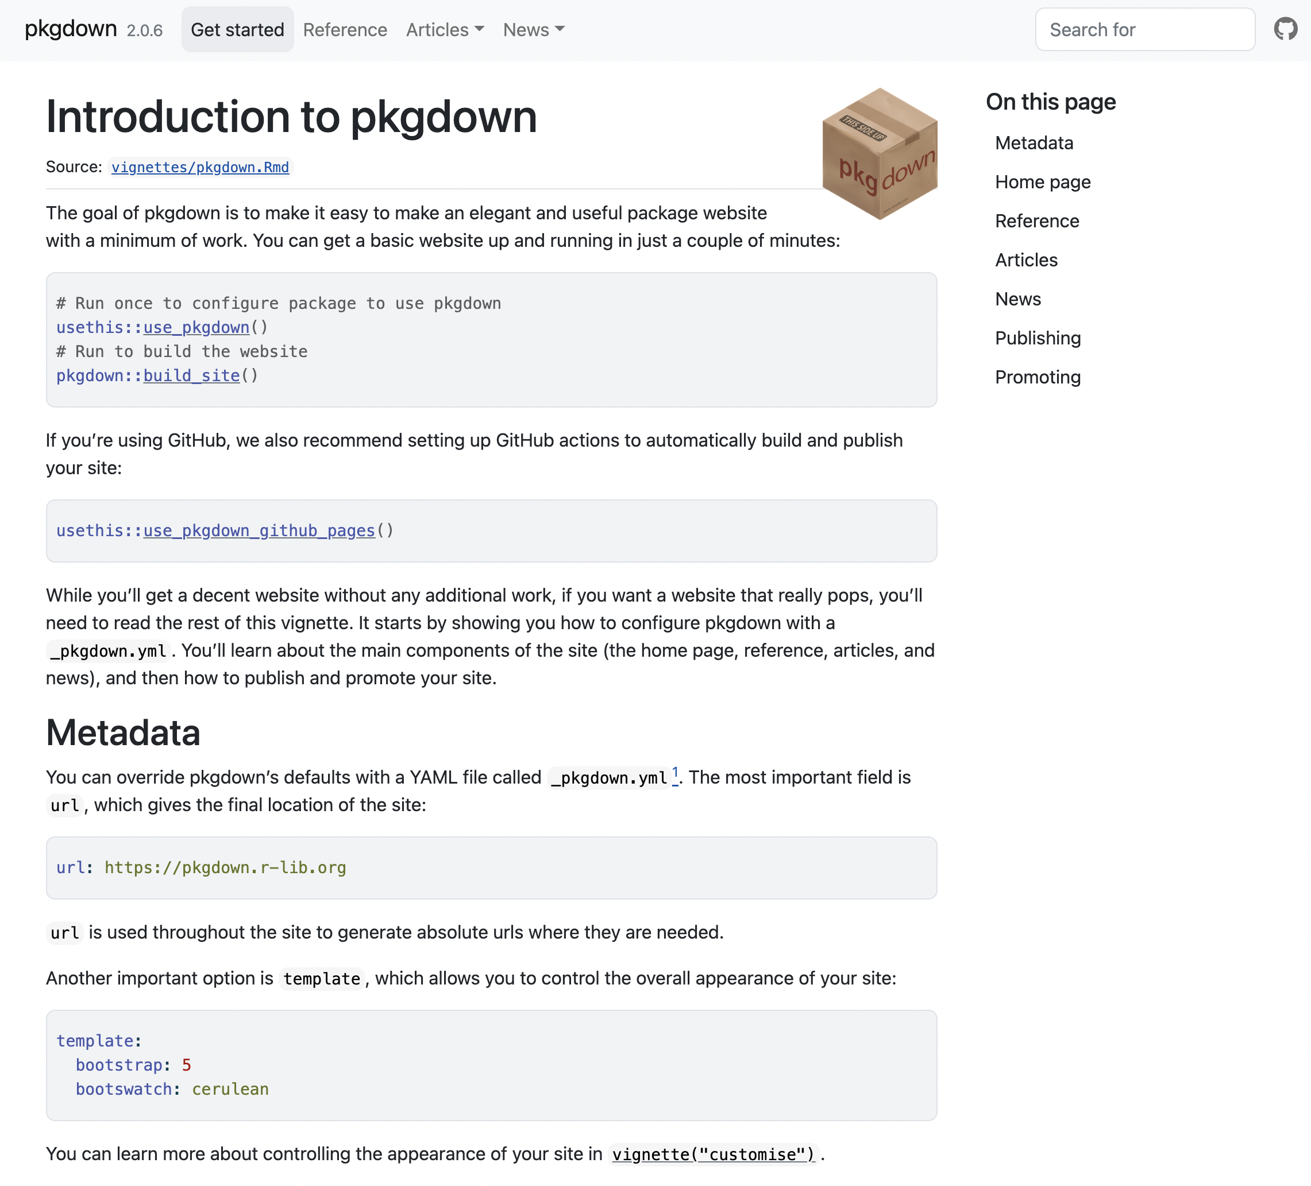
Pkgdown functionalities
Parsing of R package files in html code
vignettes/pkgdown.Rmd
pkgdown.r-lib.org/articles/pkgdown.html

Slide 10
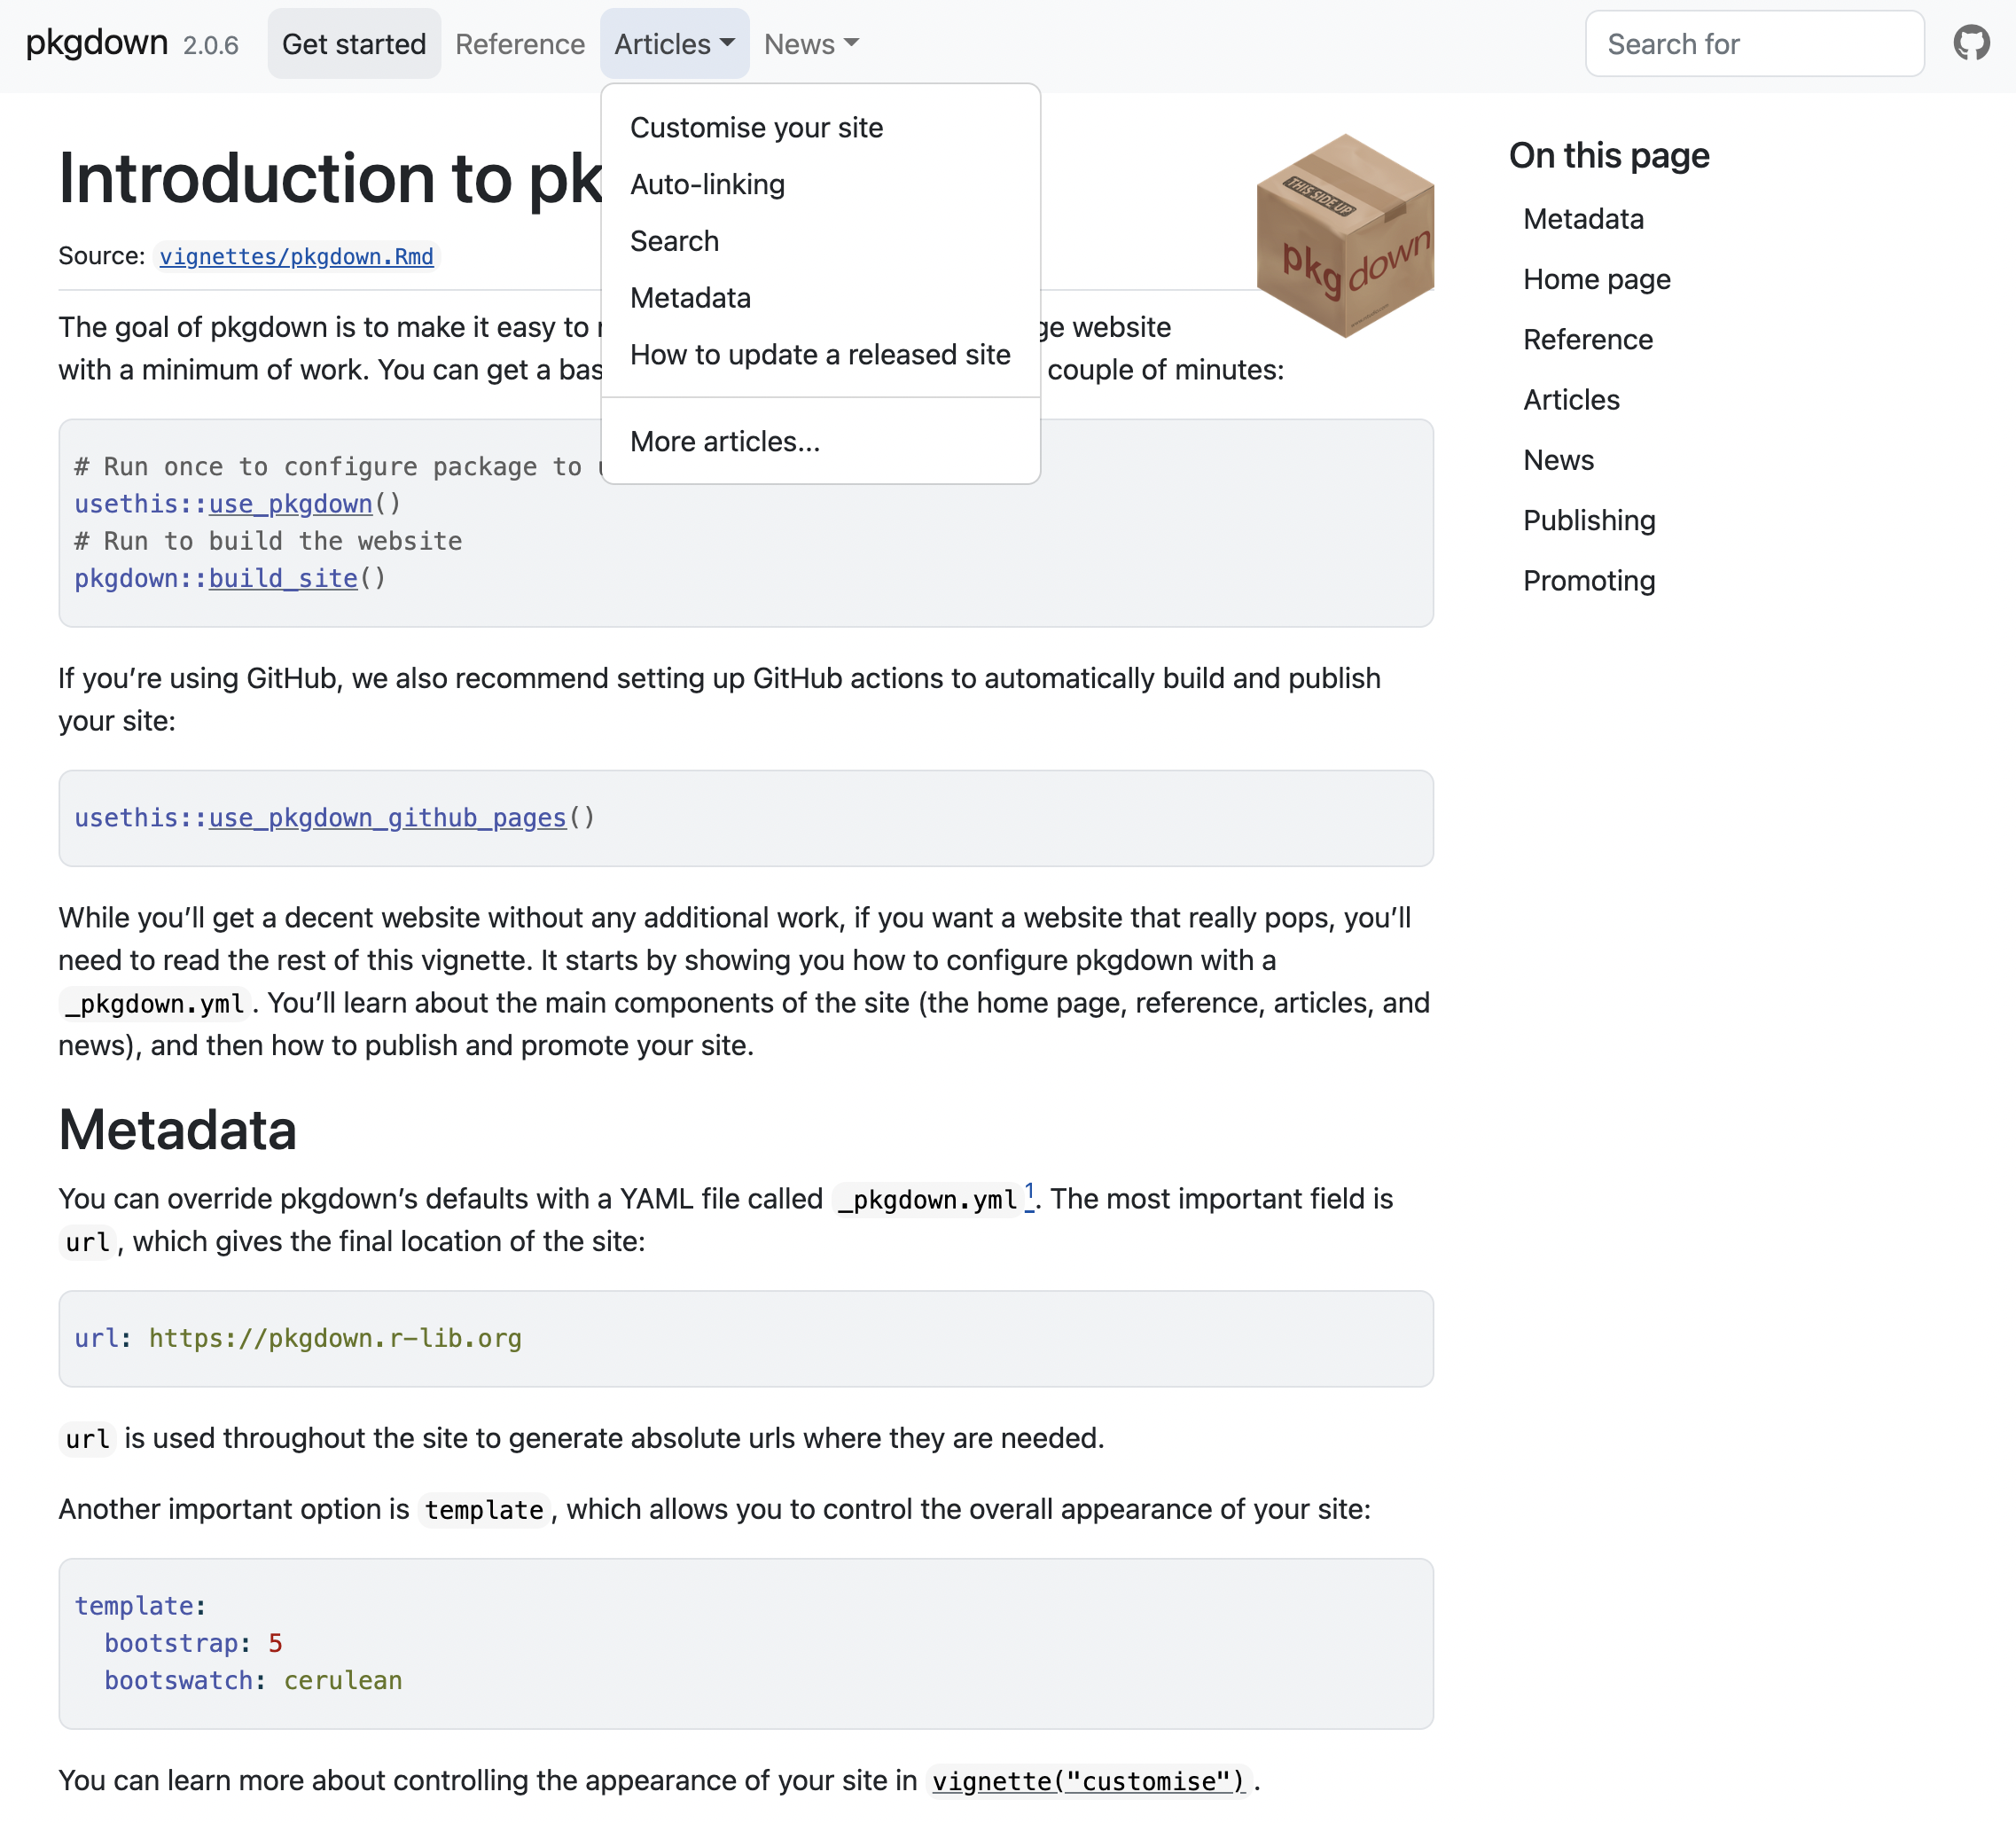
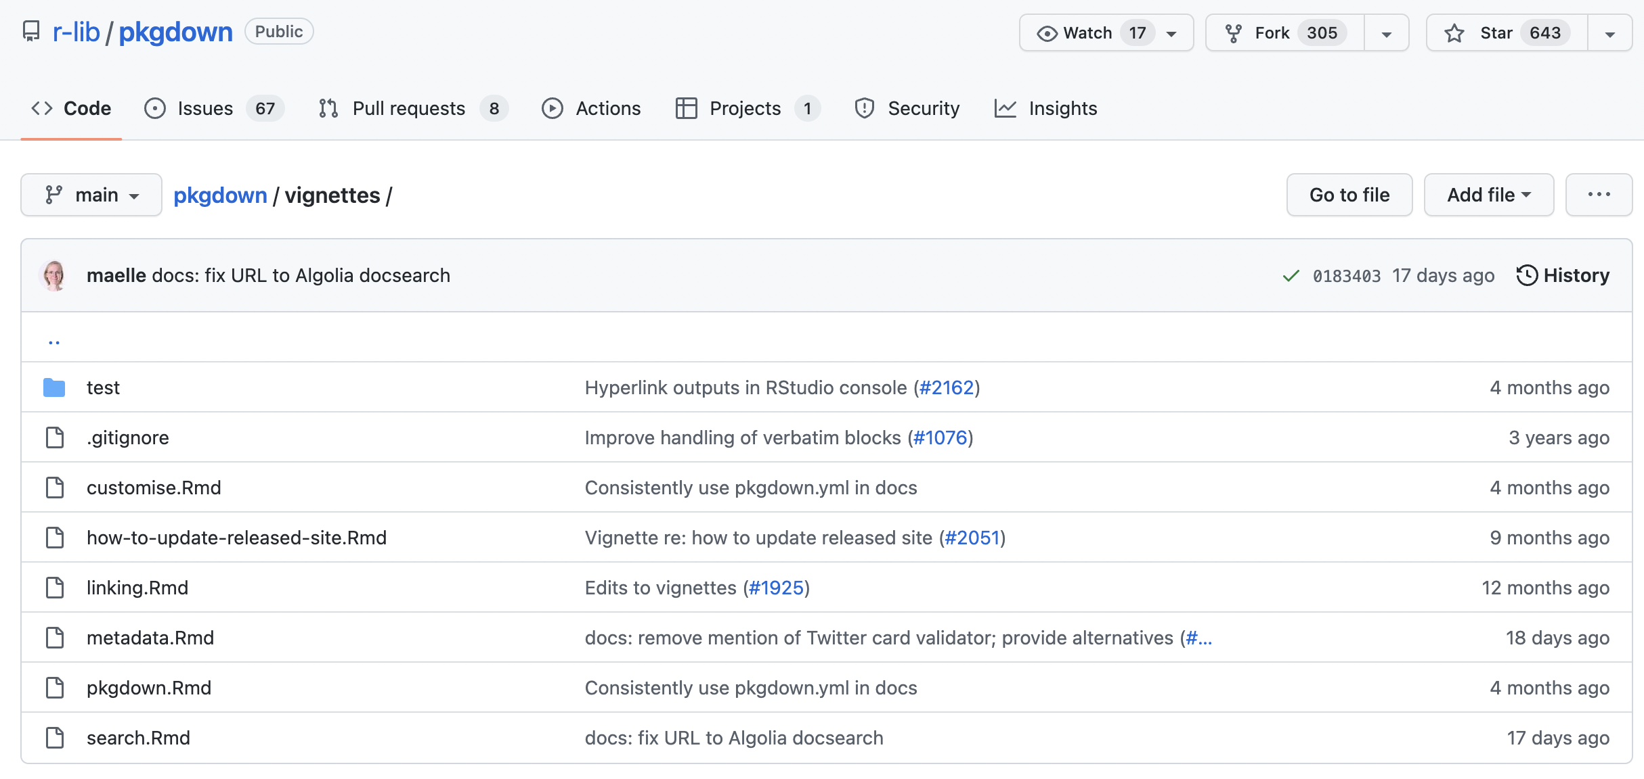
Pkgdown functionalities
Parsing of R package files in html code
vignettes/*.Rmd
pkgdown.r-lib.org/articles/pkgdown.html

Slide 11
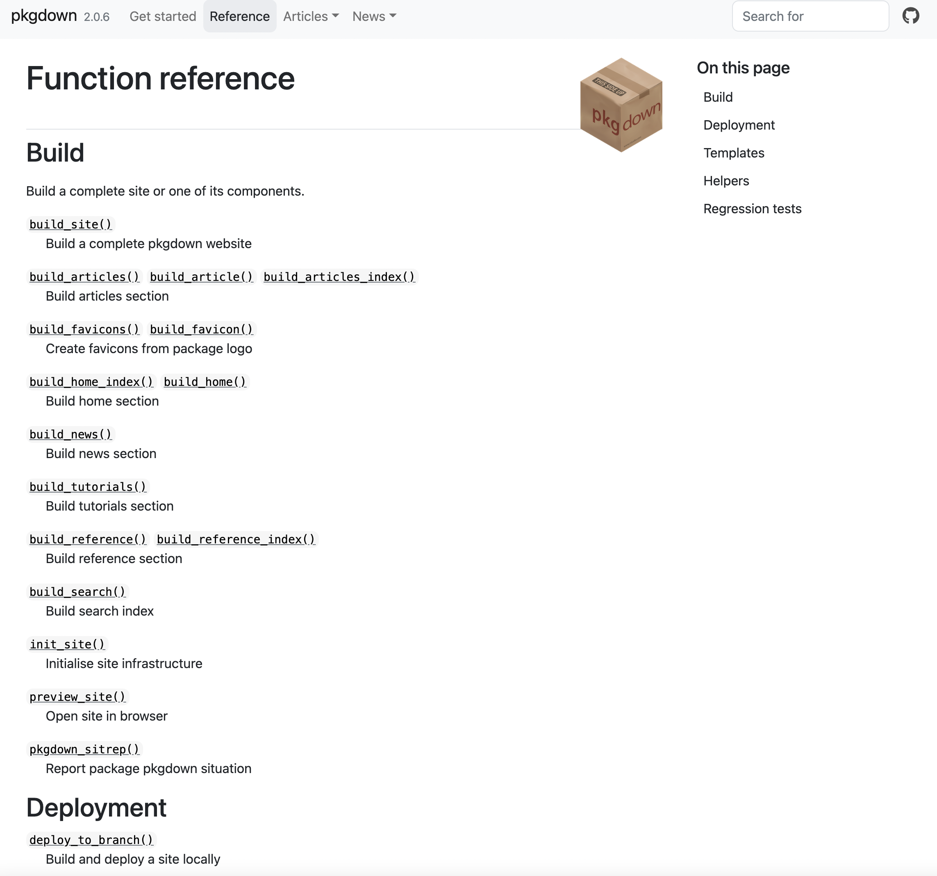
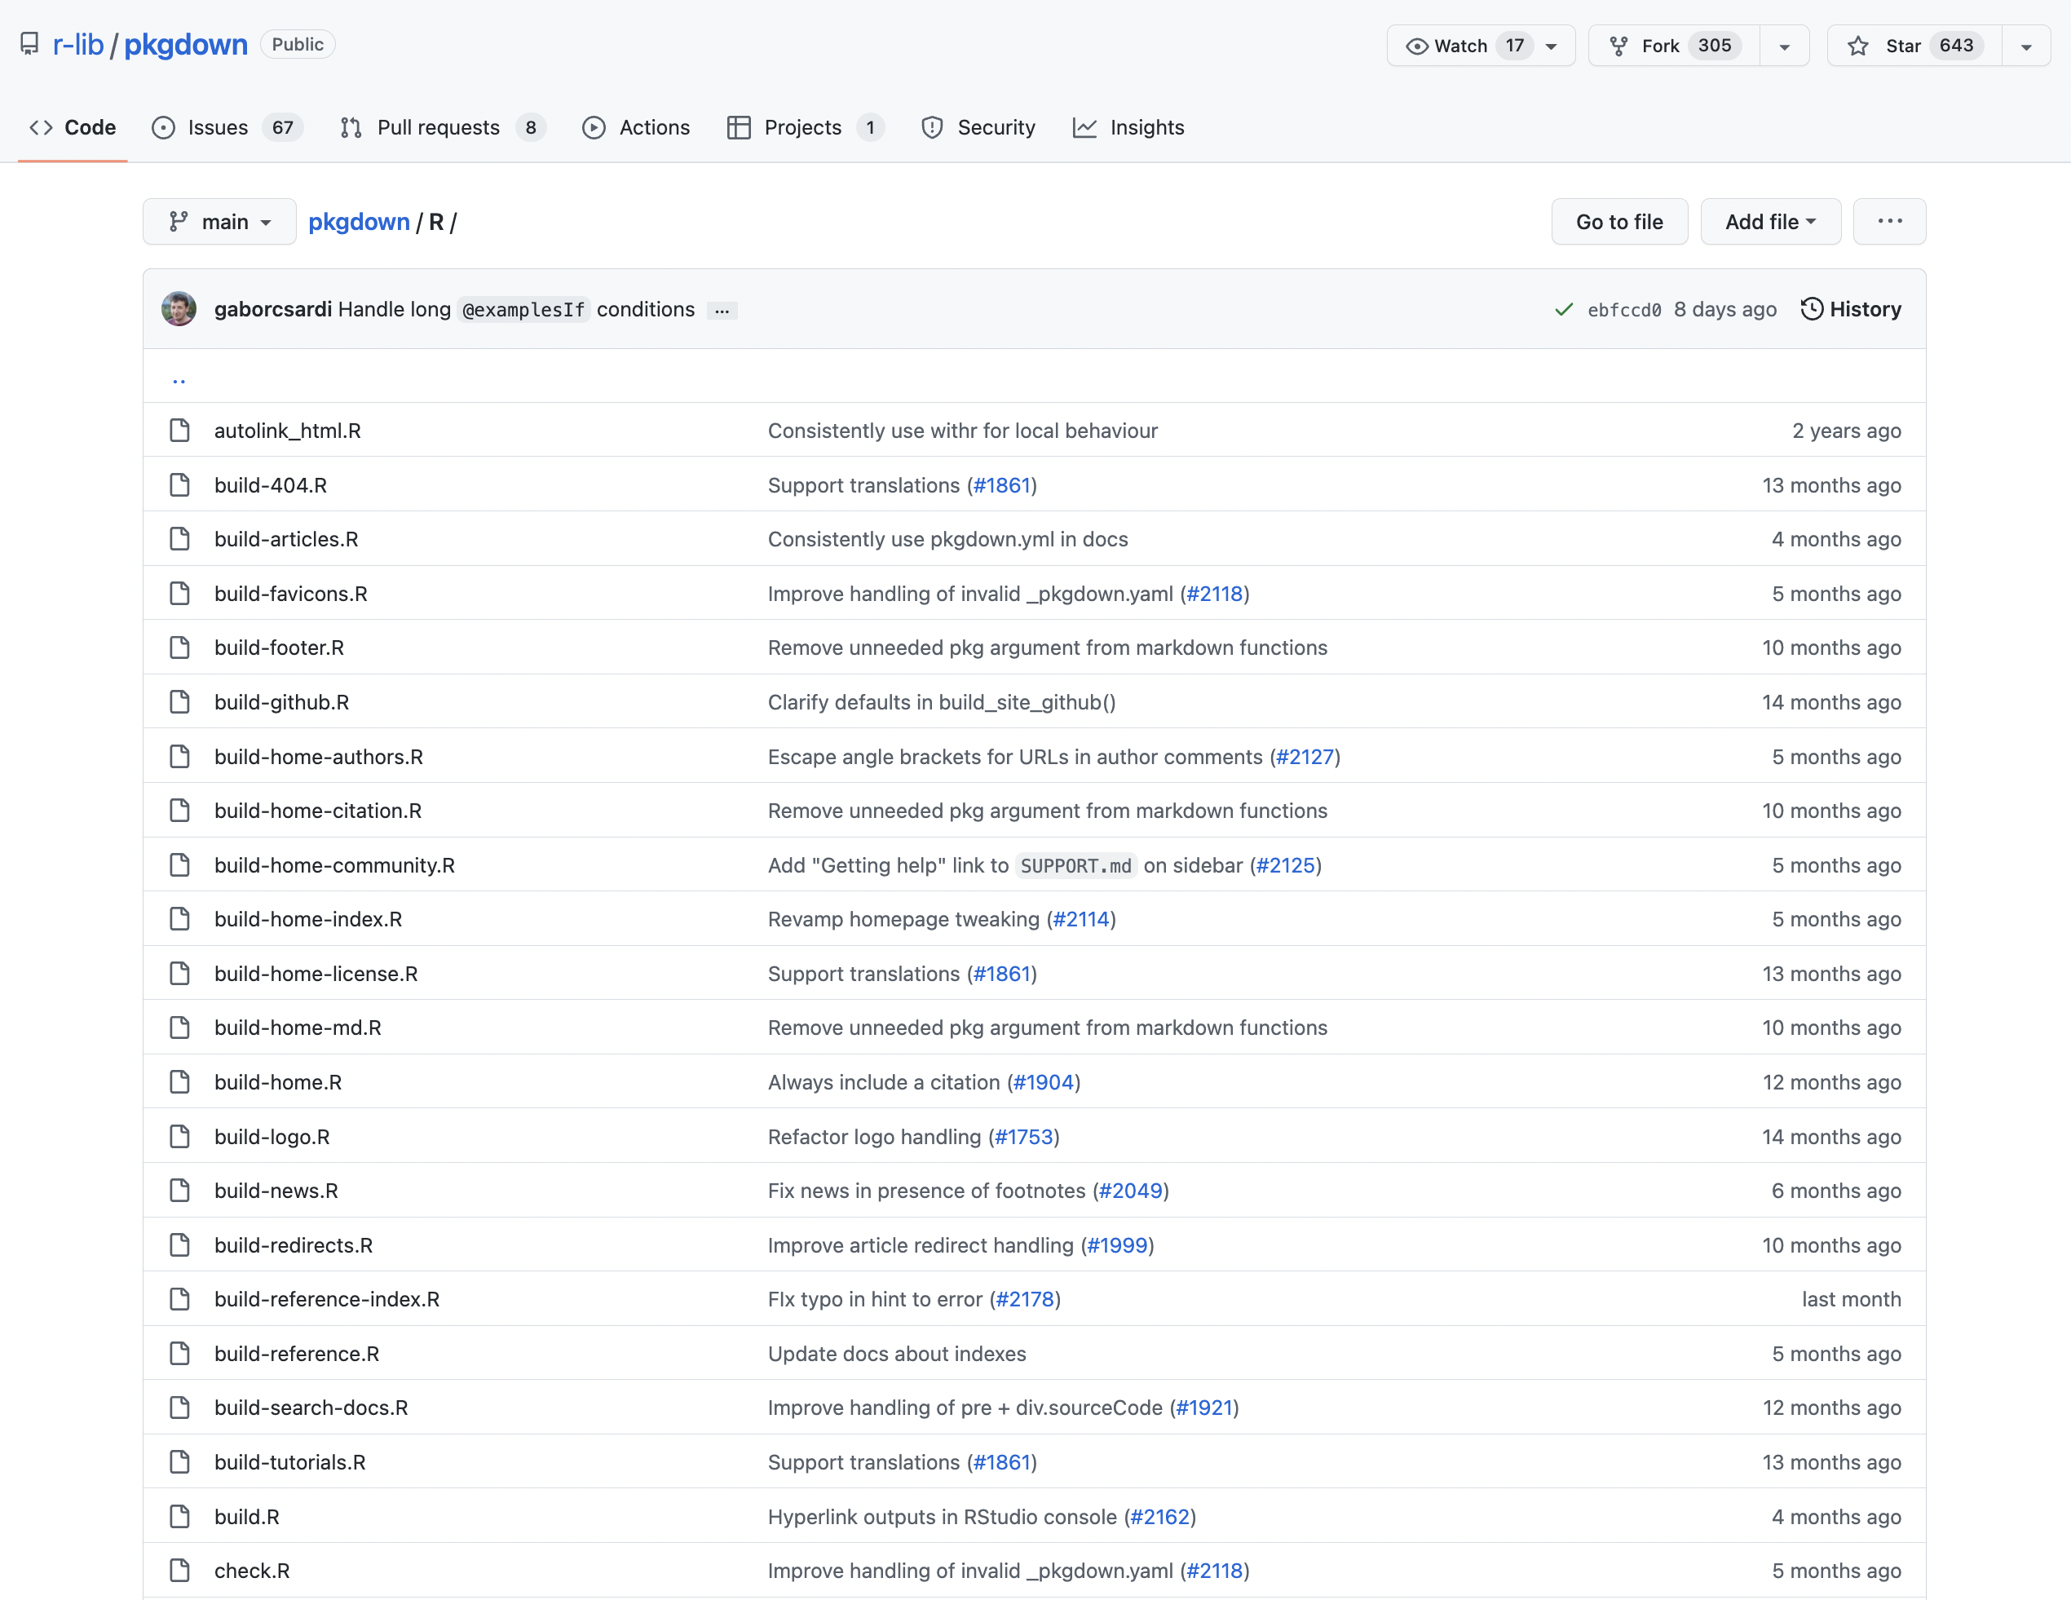
Pkgdown functionalities
Parsing of R package files in html code
List each function and link to its documentation
pkgdown.r-lib.org/reference
R/*.R

Slide 12
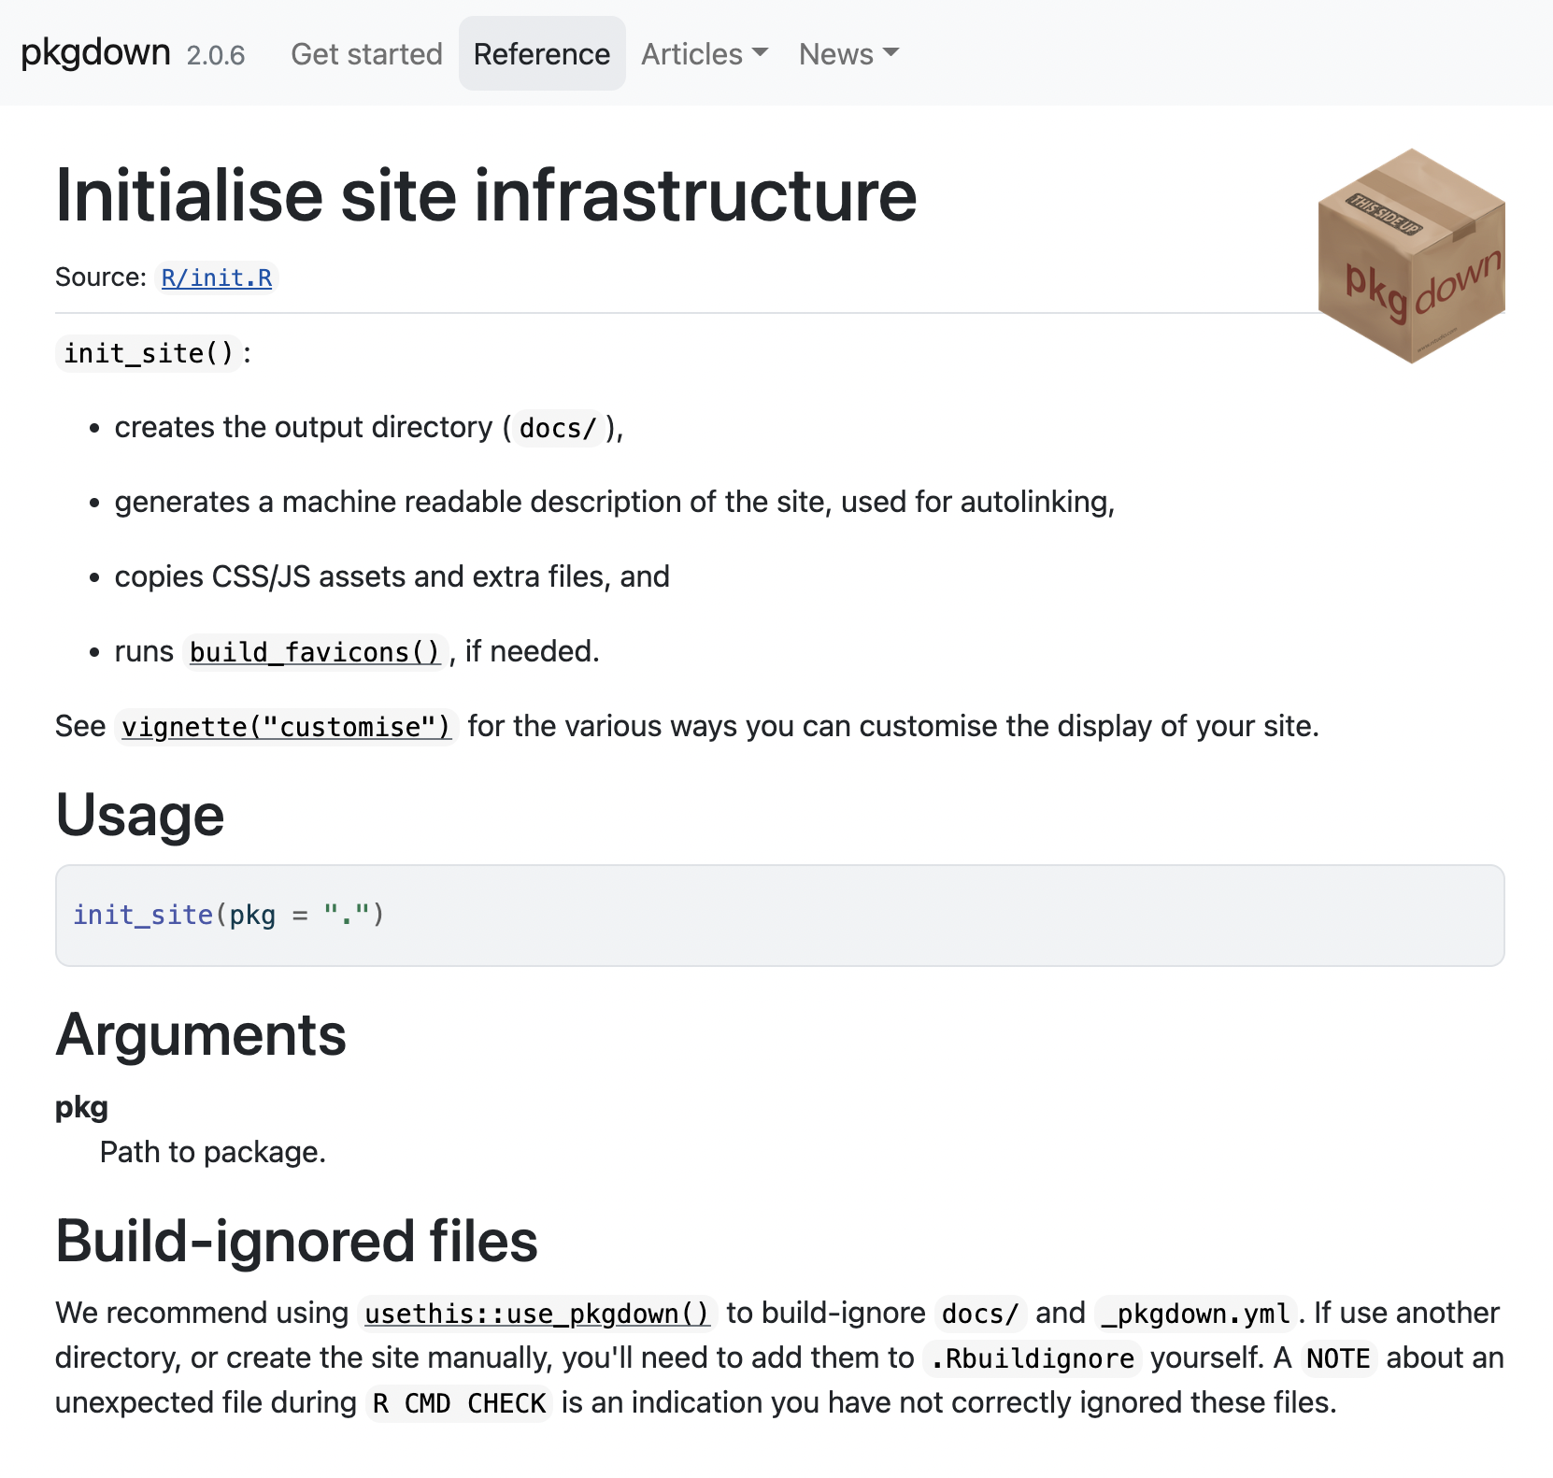
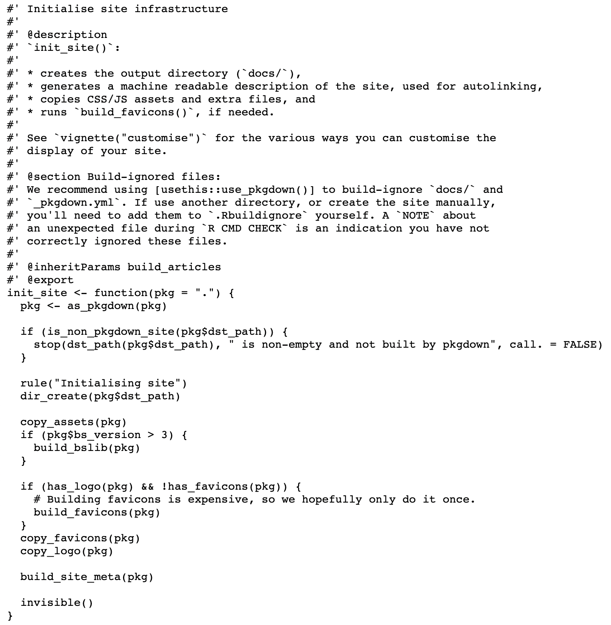
Pkgdown functionalities
Parsing of R package files in html code
List each function and link to its documentation
pkgdown.r-lib.org/reference/init_site.html
R/init.R

Slide 13
Pkgdown functionalities
Parsing of R package files in html code
List each function and link to its documentation
Auto-linking to useful resources

Slide 14
Pkgdown functionalities
Parsing of R package files in html code
List each function and link to its documentation
Auto-linking to useful resources

Slide 15
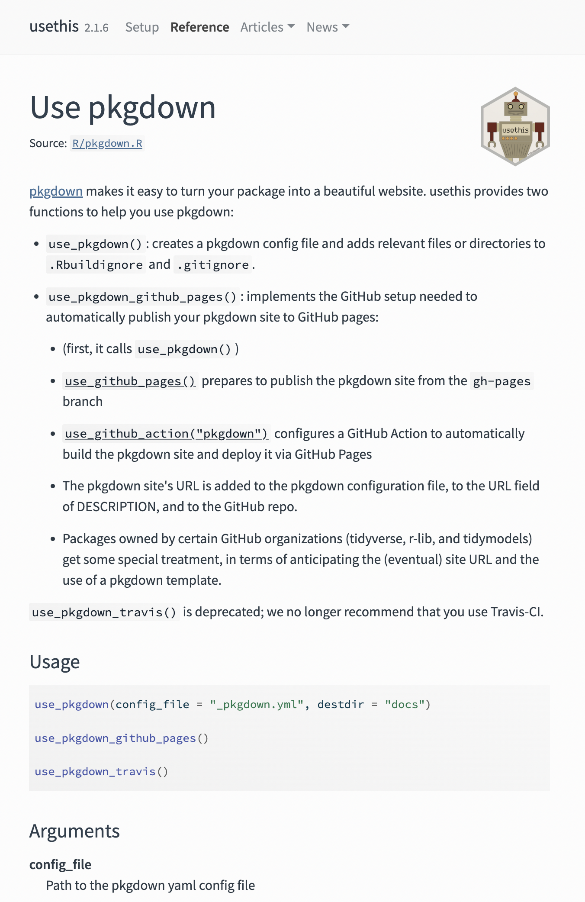
Pkgdown functionalities
Parsing of R package files in html code
List each function and link to its documentation
Auto-linking to useful resources

Slide 16
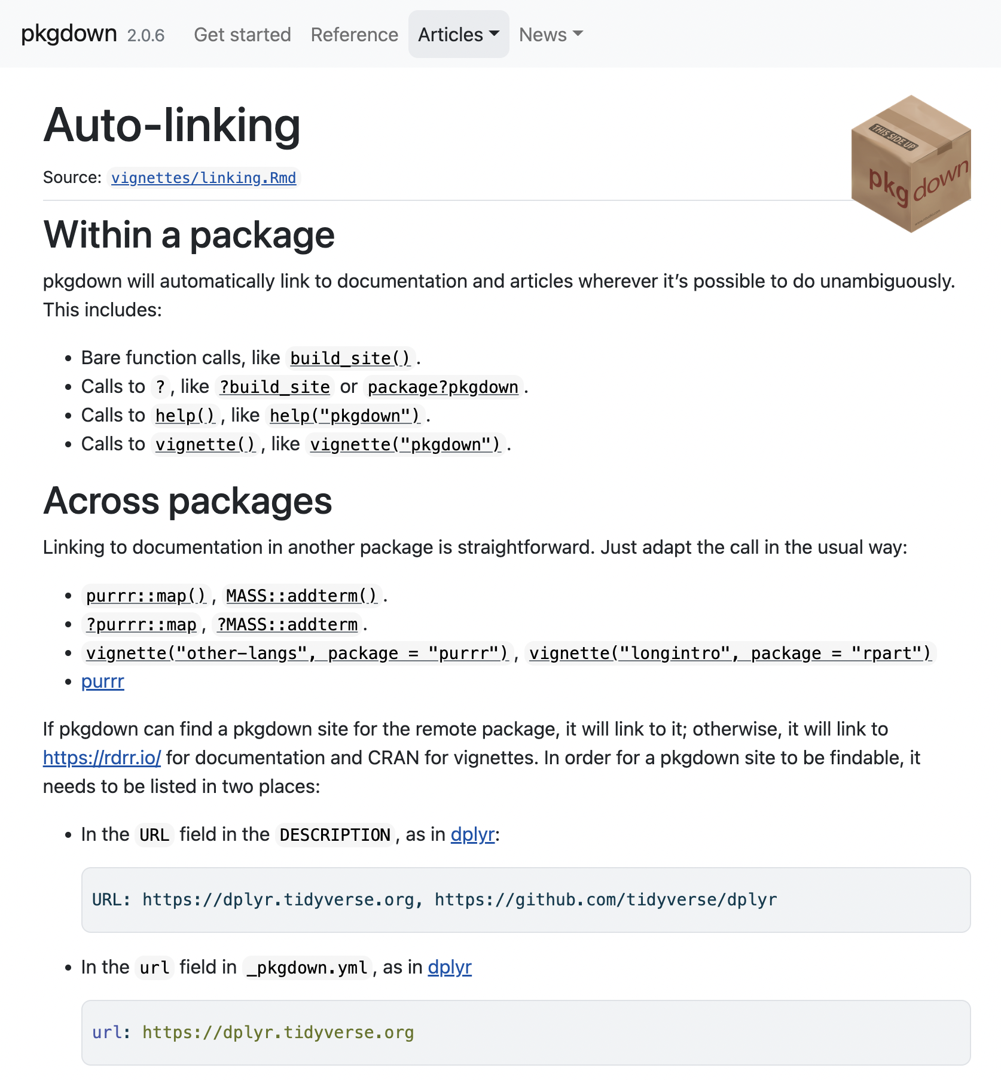
Pkgdown functionalities
Parsing of R package files in html code
List each function and link to its documentation
Auto-linking to useful resources

Slide 17
How to enable pkgdown for your own package
> install.packages("pkgdown")

Slide 18
How to enable pkgdown for your own package
_pkgdown.yml
> install.packages("pkgdown")
> usethis::use_pkgdown()
url: ~
template:
bootstrap: 5

Slide 19
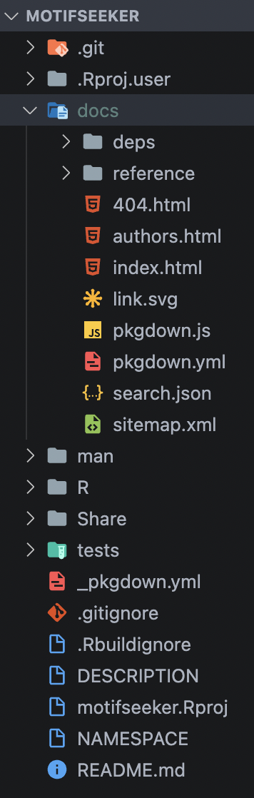
How to enable pkgdown for your own package
_pkgdown.yml
> install.packages("pkgdown")
> usethis::use_pkgdown()
> pkgdown::build_site()
url: ~
template:
bootstrap: 5

Slide 20
How to enable pkgdown for your own package
_pkgdown.yml
> install.packages("pkgdown")
> usethis::use_pkgdown()
> pkgdown::build_site()
url: ~
template:
bootstrap: 5
!!!
Git commit
Git push
!!!

Slide 21
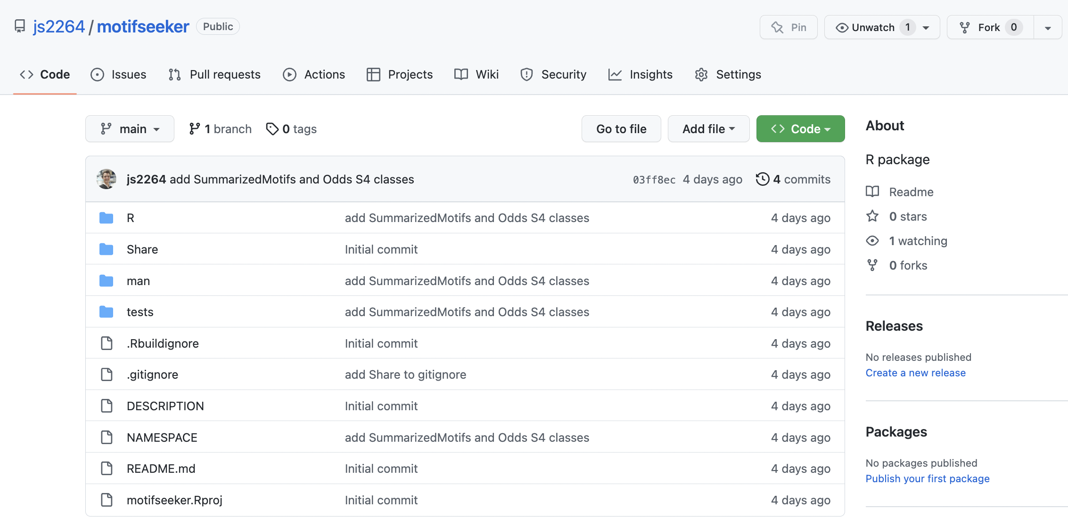
How to enable pkgdown for your own package

Slide 22
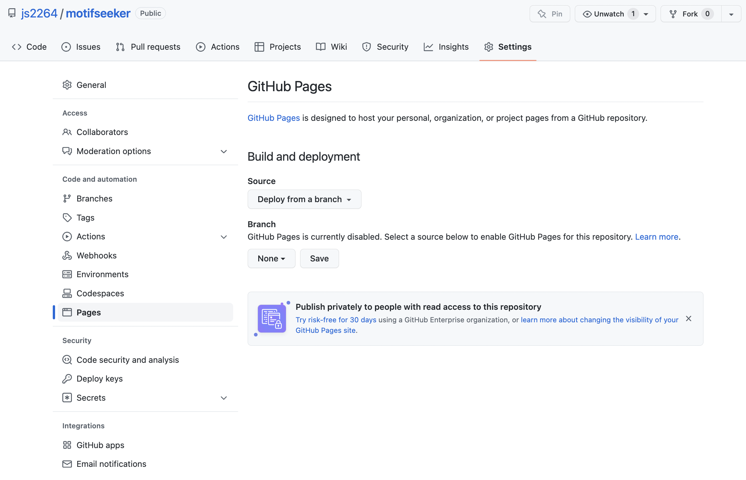
How to enable pkgdown for your own package

Slide 23
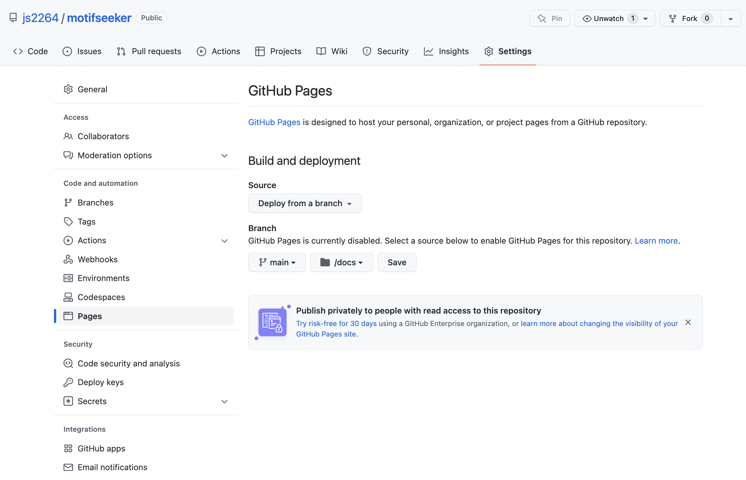
How to enable pkgdown for your own package

Slide 24
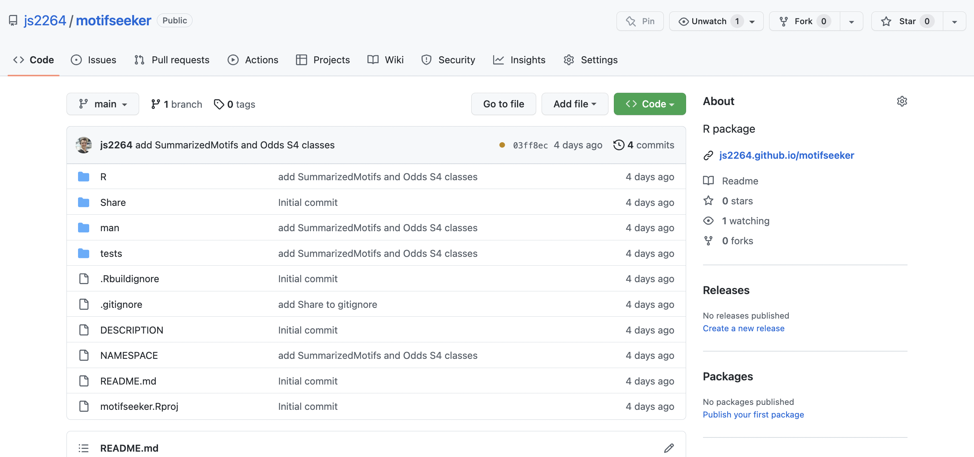
How to enable pkgdown for your own package

Slide 25
Disseminating your package
Several journals will consider submission of manuscripts describing package functionalities, e.g.:
Bioinformatics
Bioinformatics and Biology Insights
BMC Bioinformatics
BMC Systems Biology
Current Protocols in Bioinformatics
eLife (Tools and Resources)
F1000 Research
Nature Methods
PeerJ
PLoS Computational Biology: Software collection

Slide 26

F1000 Research & Bioconductor gateway

Slide 27
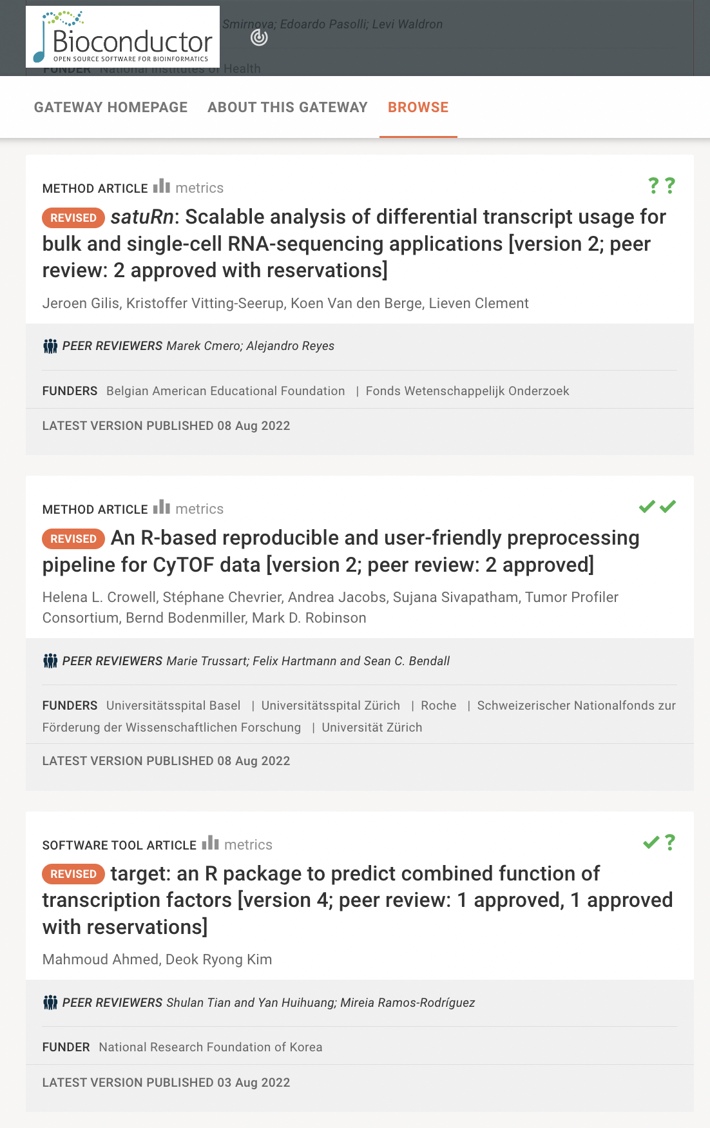
F1000 Research & Bioconductor gateway

Slide 28
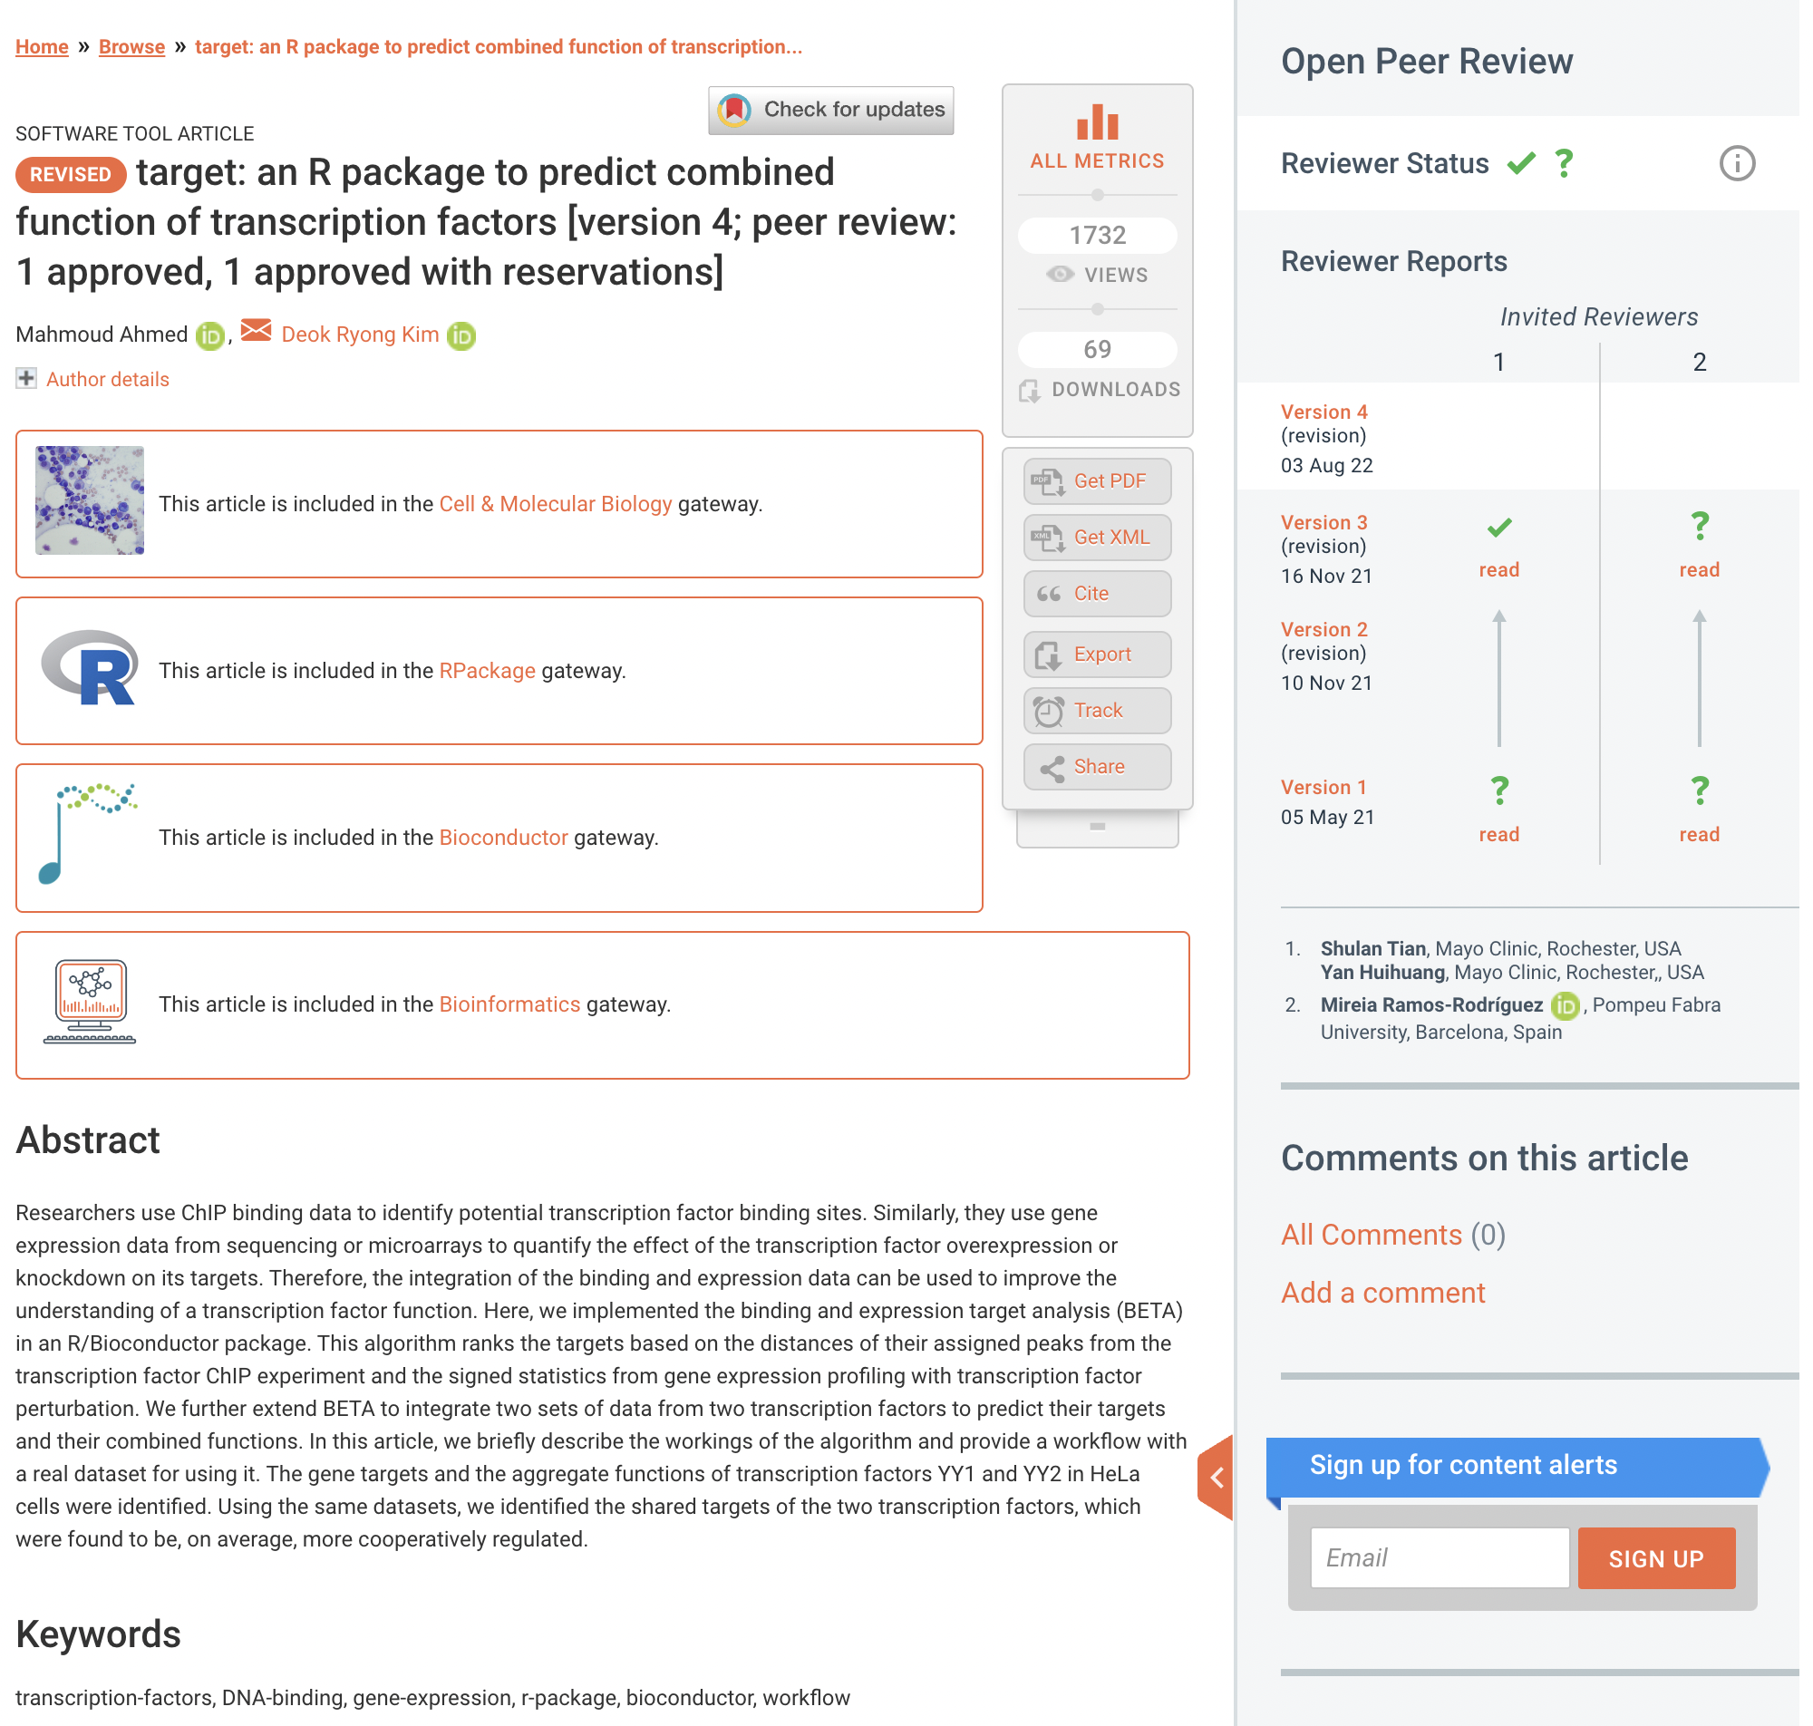
F1000 Research & Bioconductor gateway

Slide 29

Other less “official” bioinformatic package editors

Slide 30
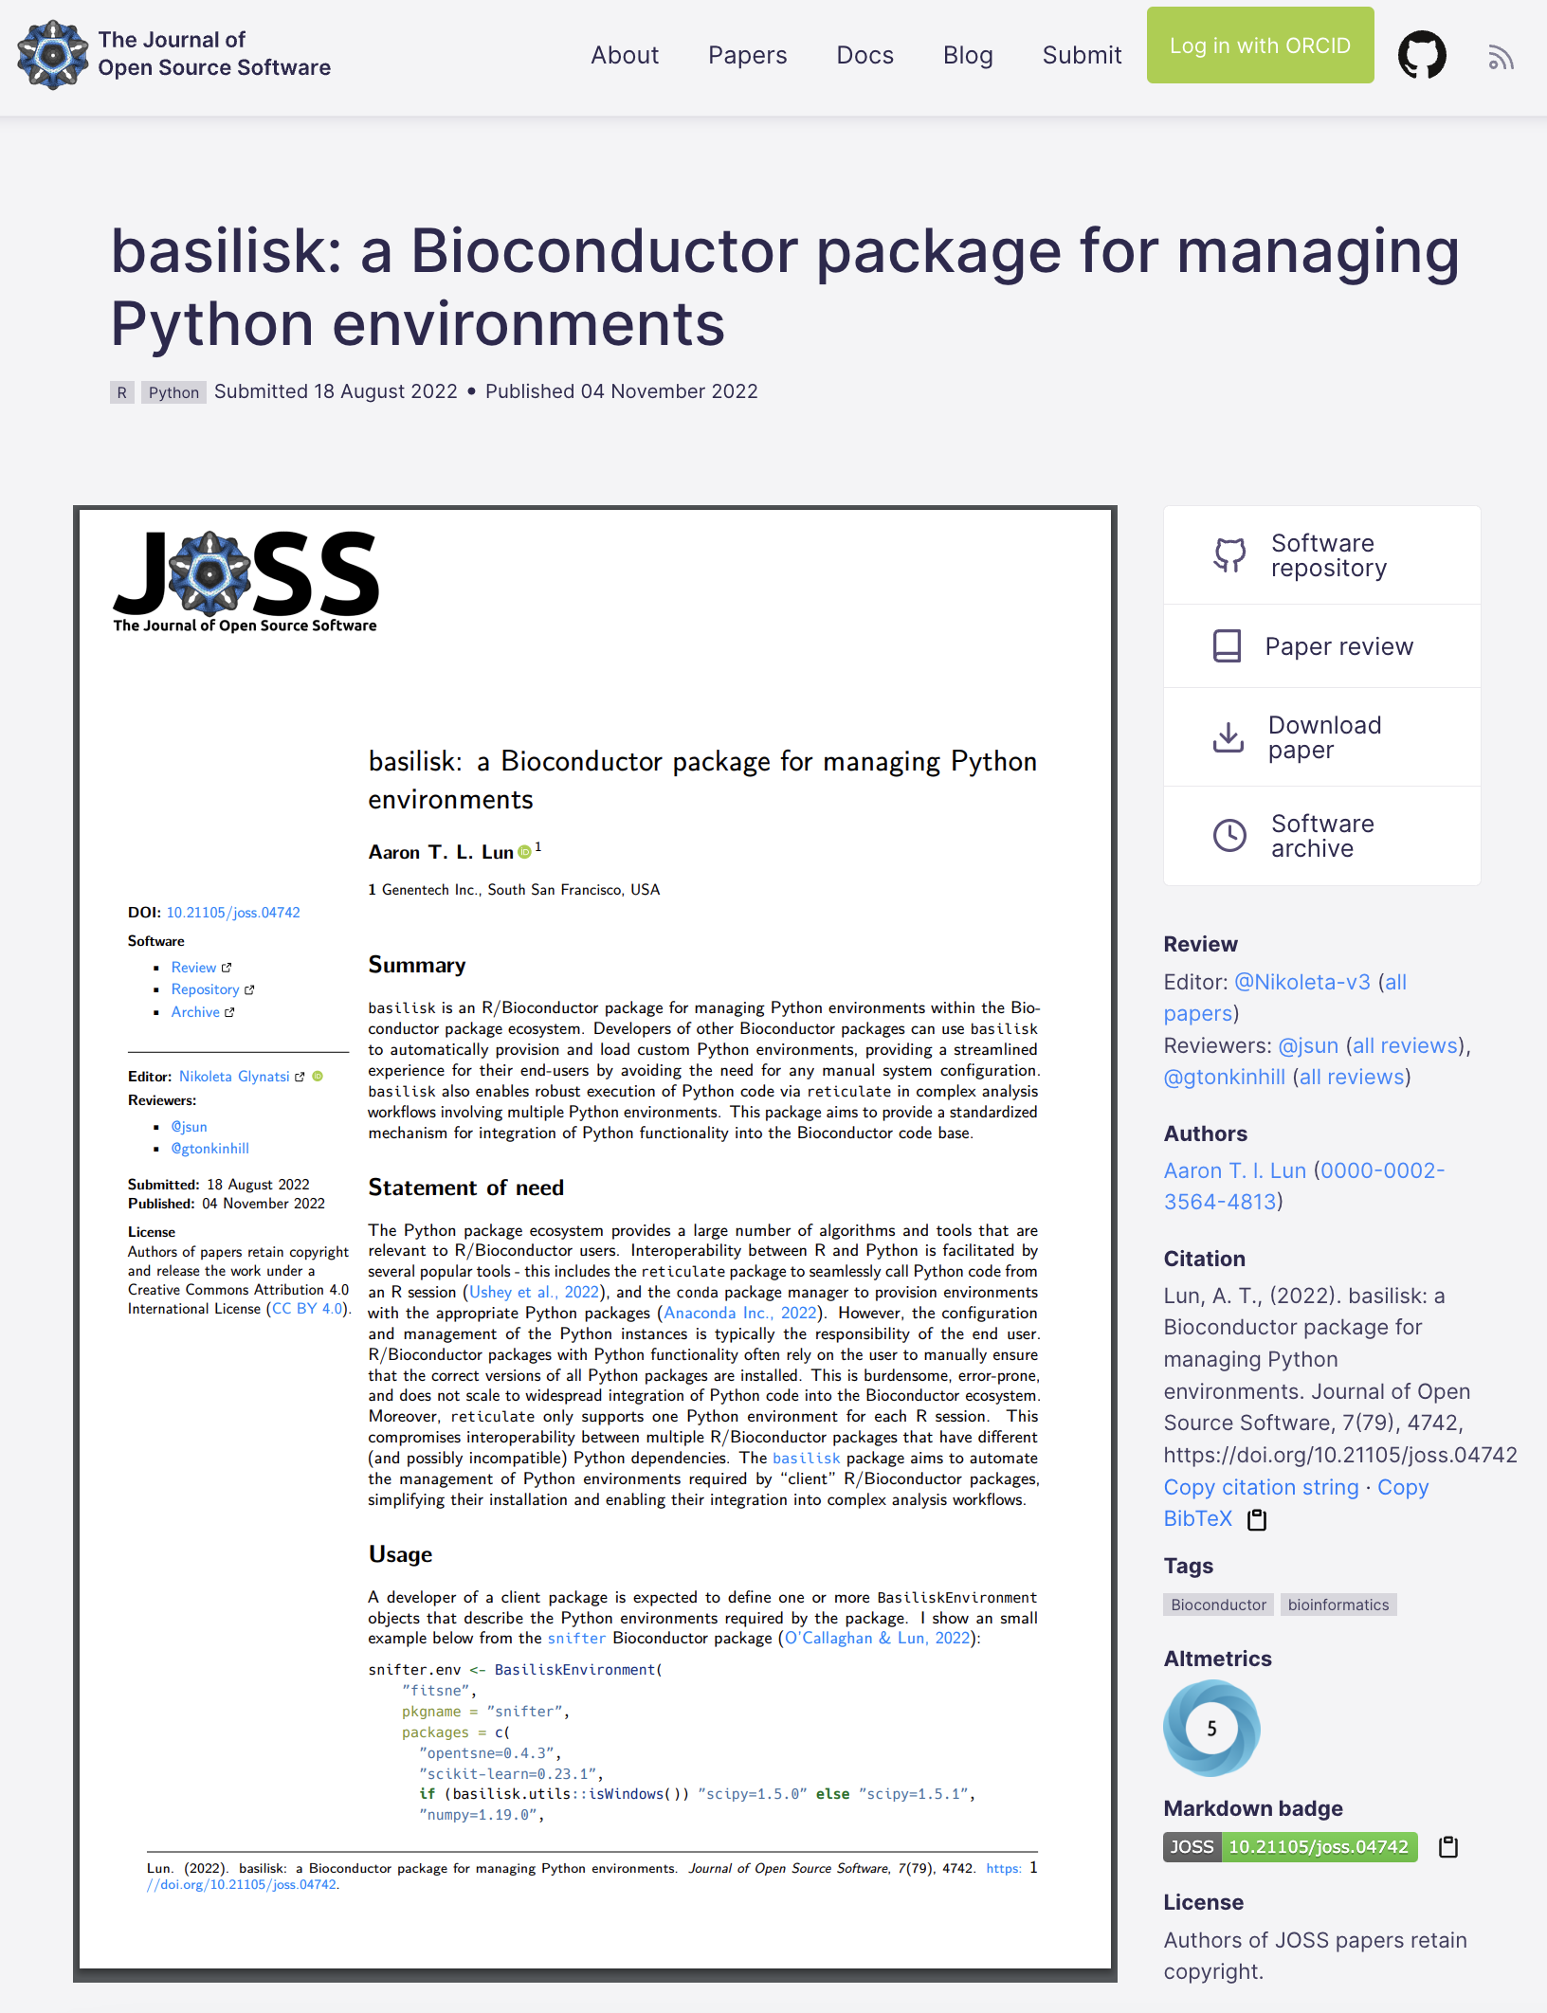
Other less “official” bioinformatic package editors

Slide 31
Other less “official” bioinformatic package editors
github.com/LTLA/basilisk

Slide 32
JOSS paper review: takes place on GitHub!
github.com/openjournals/joss-reviews/issues/4742

Slide 33
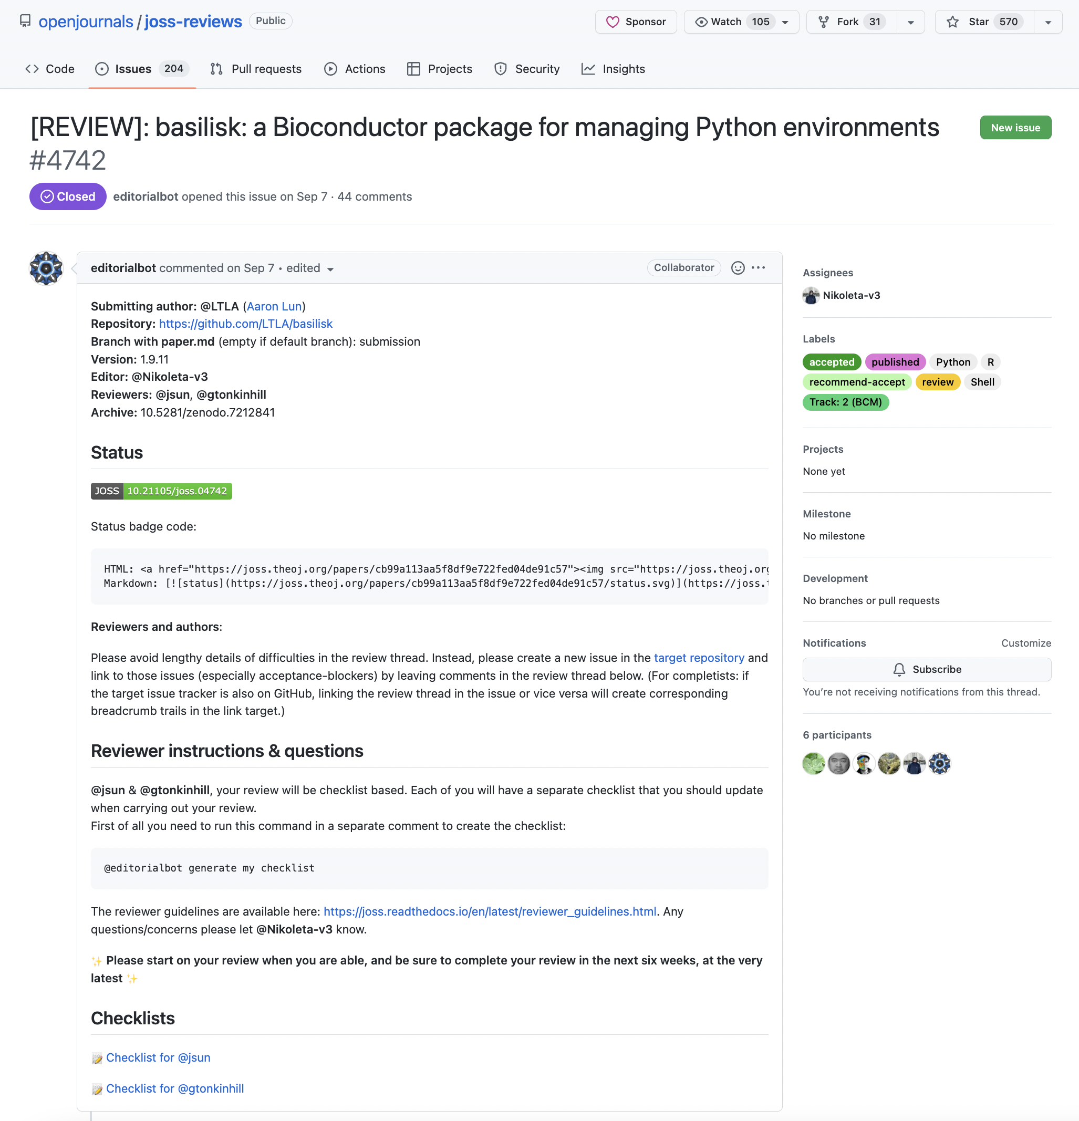
JOSS paper review: takes place on GitHub!

Slide 34
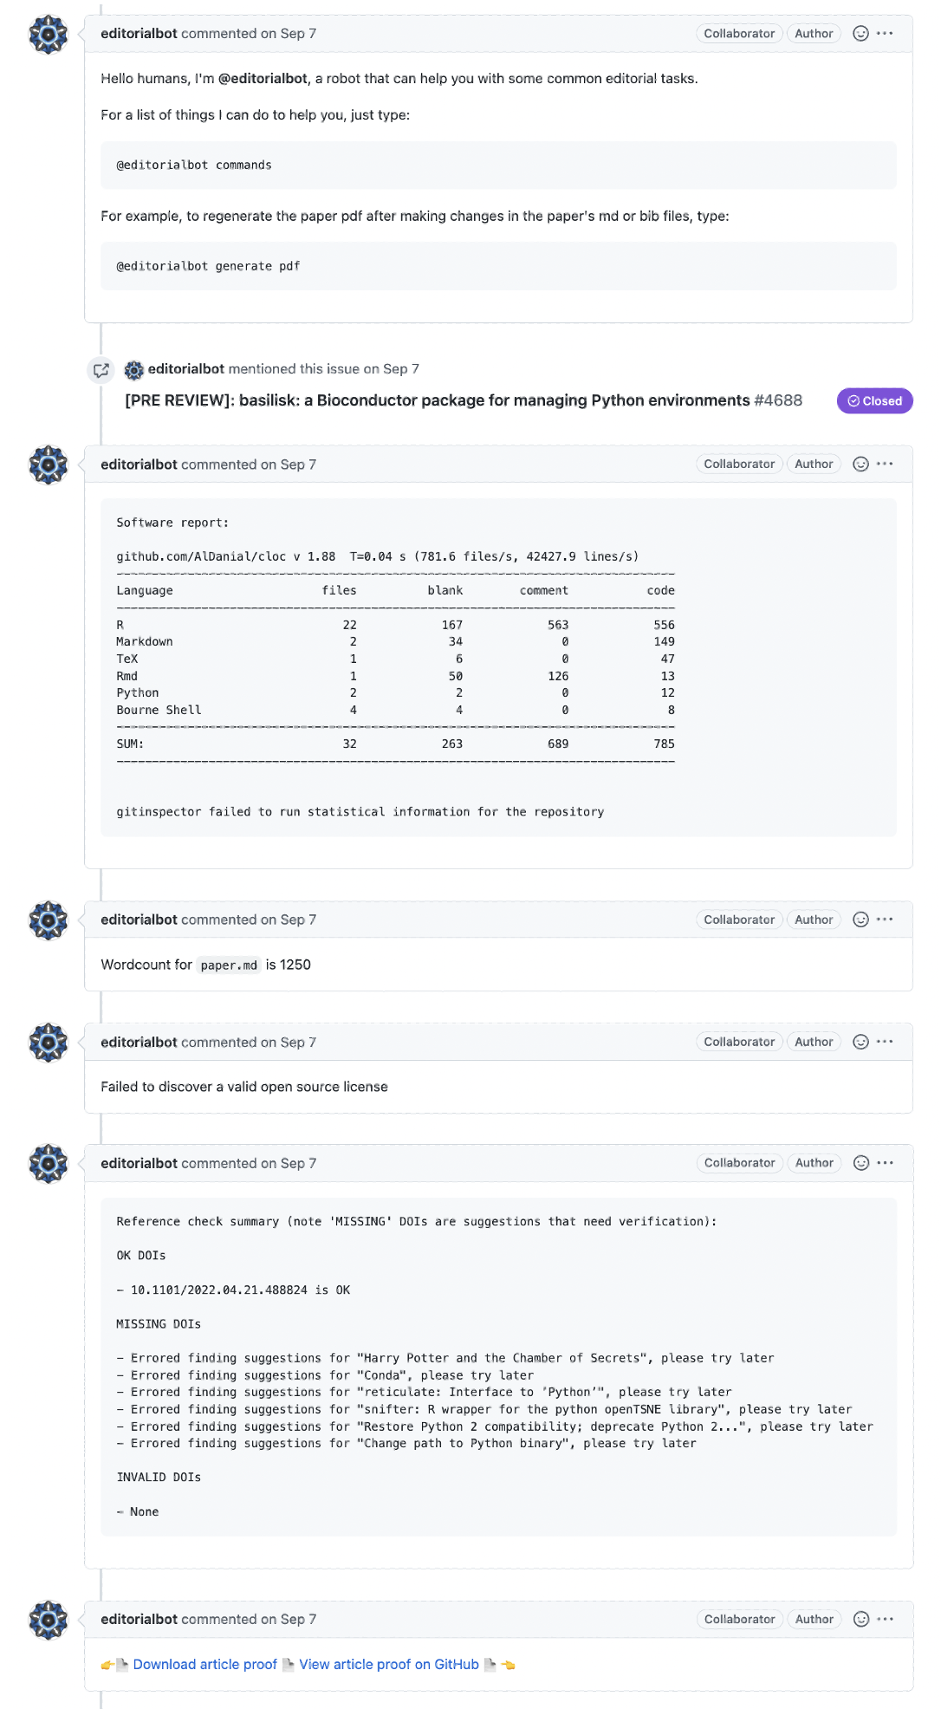
JOSS paper review: takes place on GitHub!

Slide 35
JOSS paper review: takes place on GitHub!

Slide 36
JOSS paper review: takes place on GitHub!

Slide 37
JOSS paper review: takes place on GitHub!

Slide 38
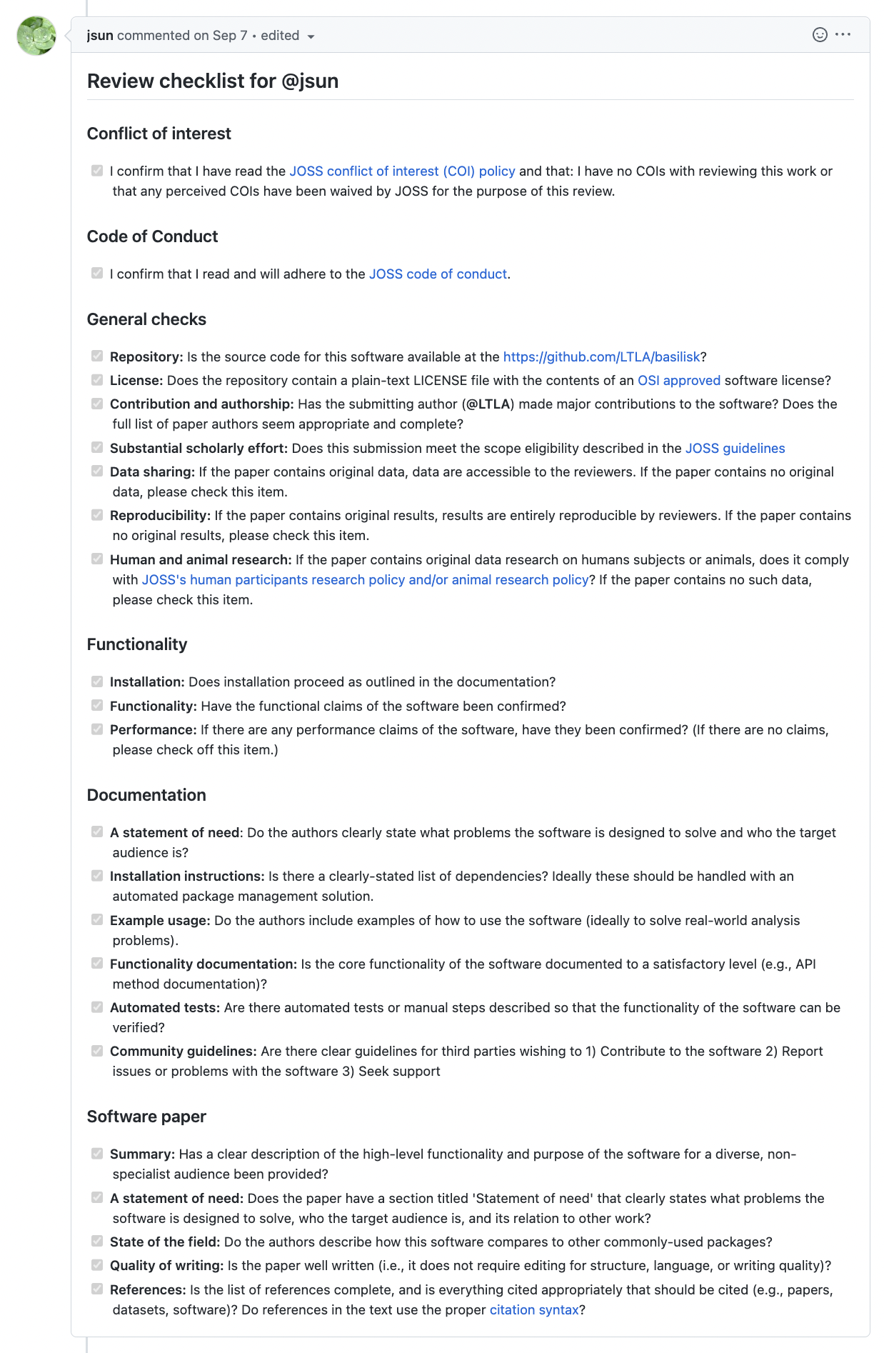
JOSS paper review: takes place on GitHub!

Slide 39
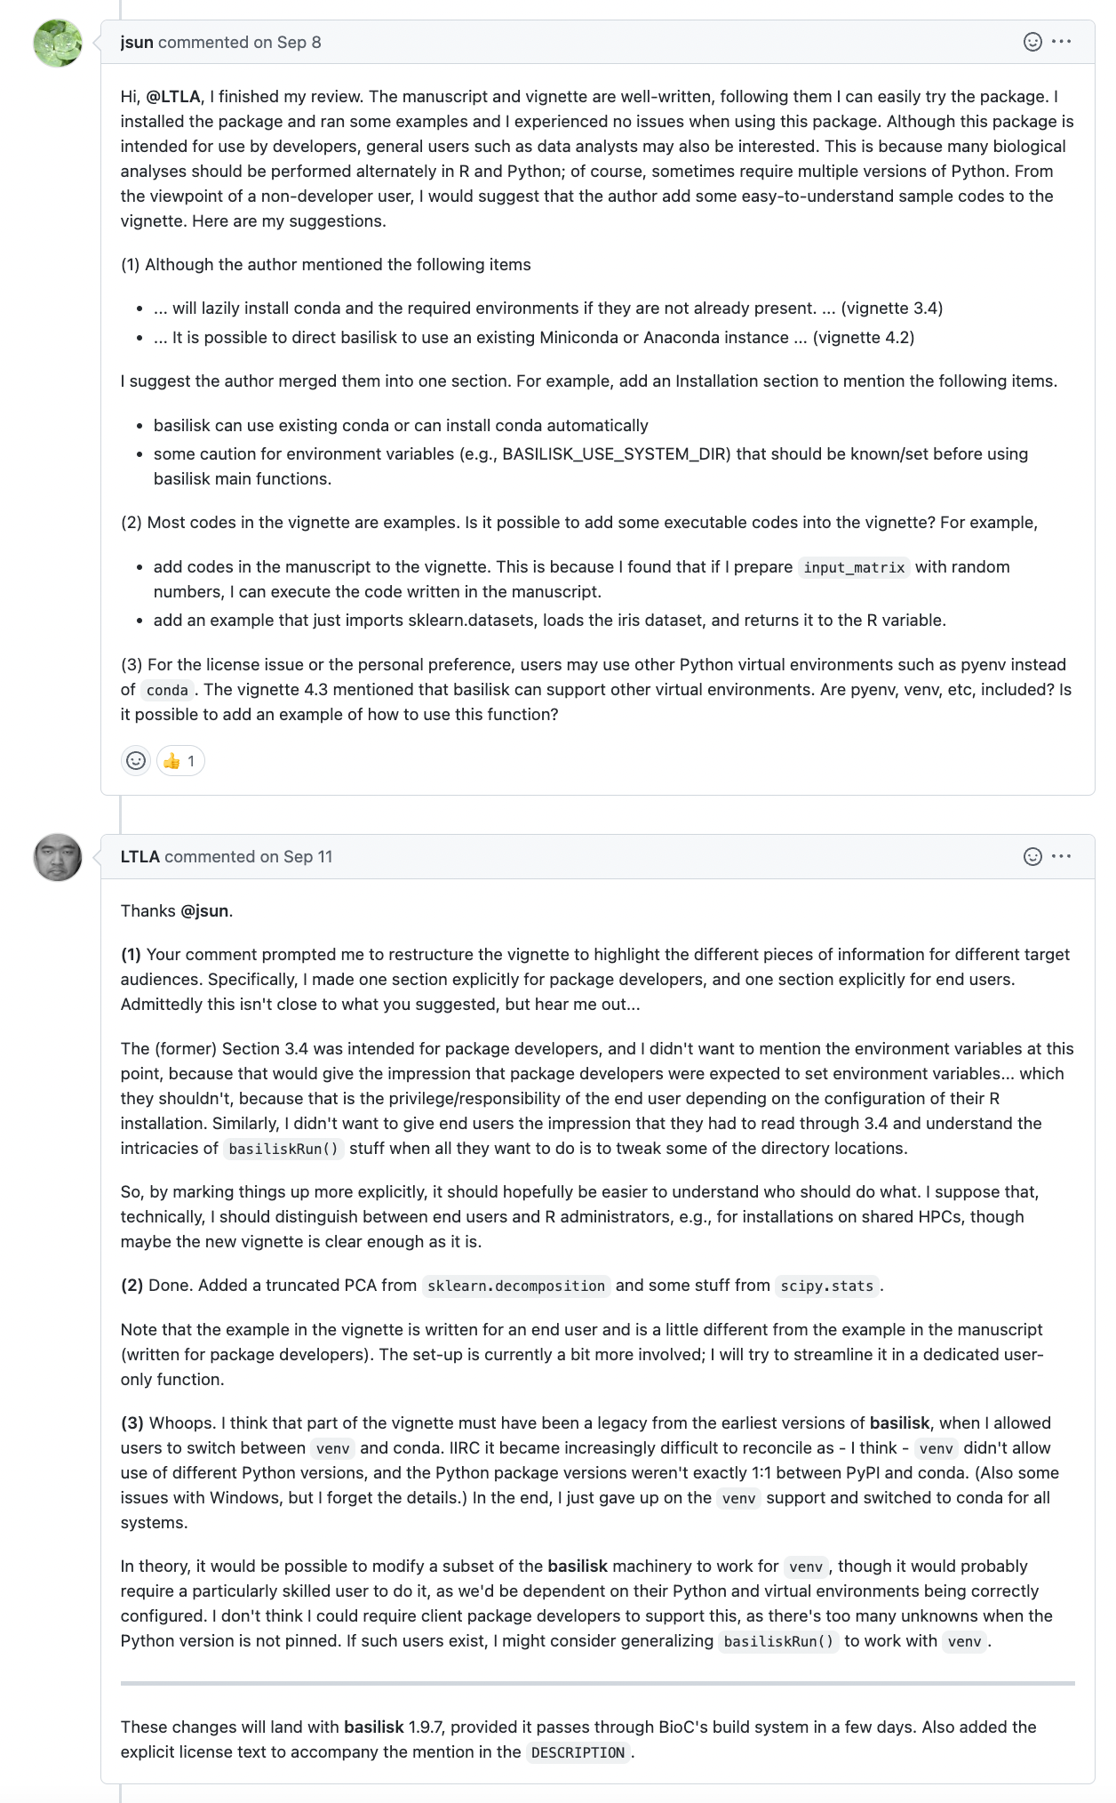
JOSS paper review: takes place on GitHub!

Slide 40
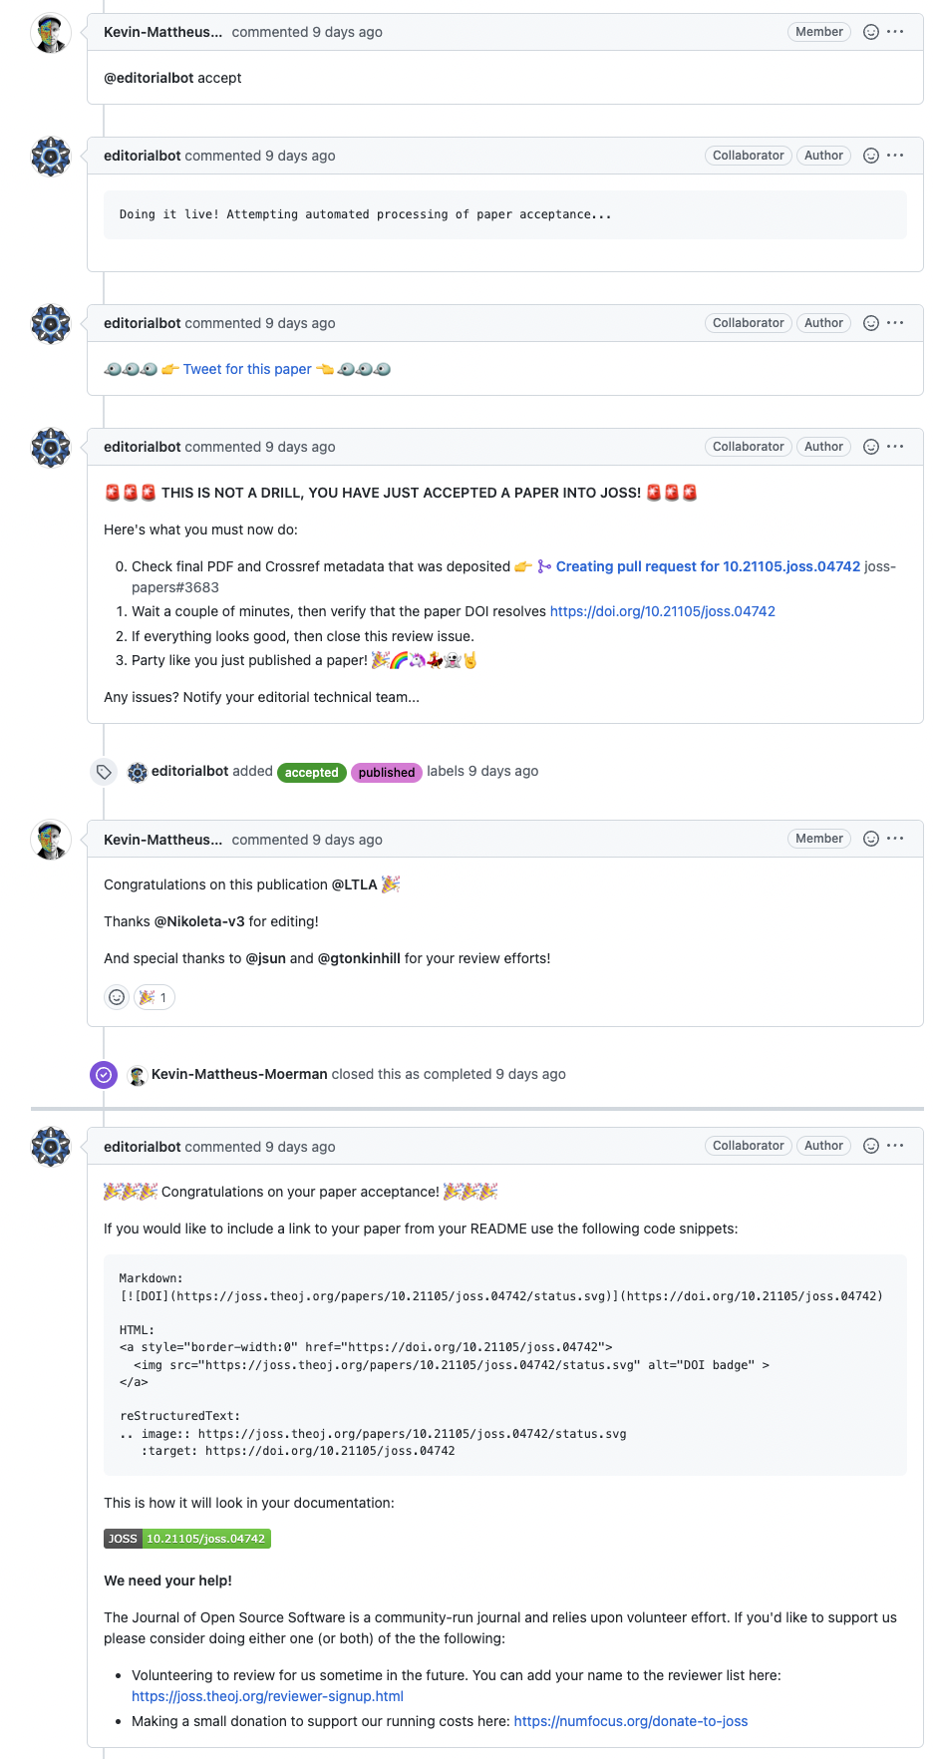
JOSS paper review: takes place on GitHub!

Slide 41
JOSS paper review: takes place on GitHub!

Slide 42
JOSS paper review: takes place on GitHub!

Slide 43
JOSS paper review: takes place on GitHub!

